Slide 1

Advance Check-in Registration Site
Instruction Manual
～English～
2025.06.13 Ver.1.2
株式会社コモンプロダクツ

Slide 2
Table of Contents
01
Advance Check-in Registration Site Instruction Manual pp.1-16
02
If you wish to continue registering information for accompanying guests pp.10-12
03
If each companion will complete their own registration pp.13-16
04
About Check-in pp.17-24
05
About Check-out pp25-27
06
Checking and Editing Advance Registration Statuspp. pp.29-32
07
Changing Your Password or Email Address, and How to Cancel Your Account pp.33-35
08
Editing Check-in Information Registered to Your Account pp.36-38
09
How to Issue a Reservation Only and Complete Advance Check-in Later pp39-41

Slide 3
Advance Check-in Registration Site
Instruction Manual
ｐ.1

Slide 4

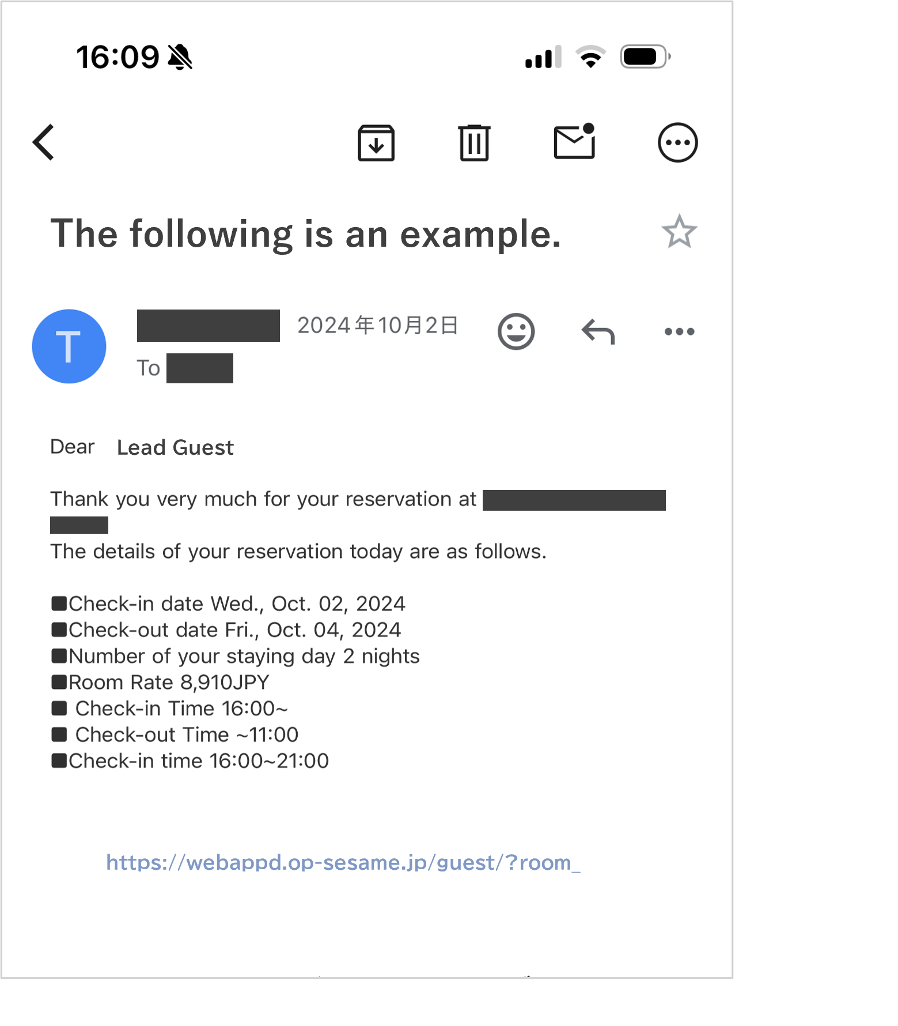
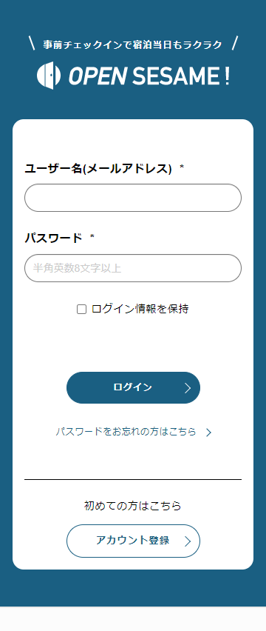
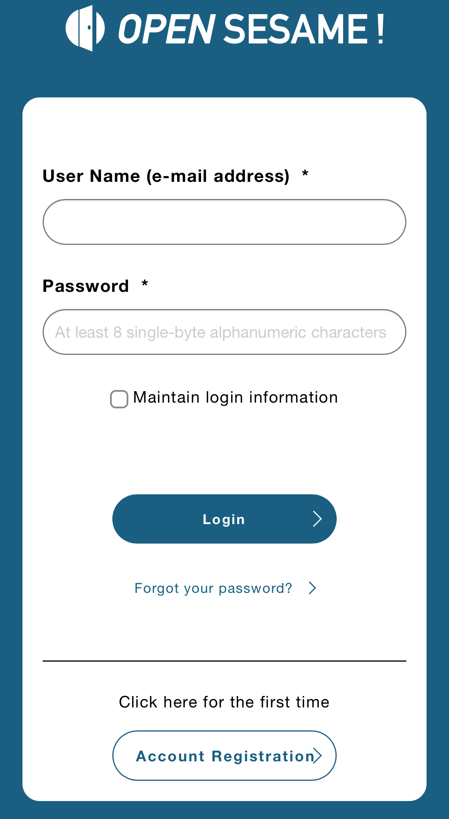

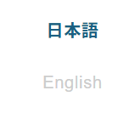
How to Use the Advance Check-in Registration Site
1.Please tap the URL of the pre-registration
site provided through the booking site,
or copy and search the URL using your browser.
2. For first-time users, please click "Create Account".
Returning users can log in with their credentials.
01
02
If the language is set to Japanese,
select option ① and change it to English.
The site is also accessible from a computer.
ｐ.2

Slide 5
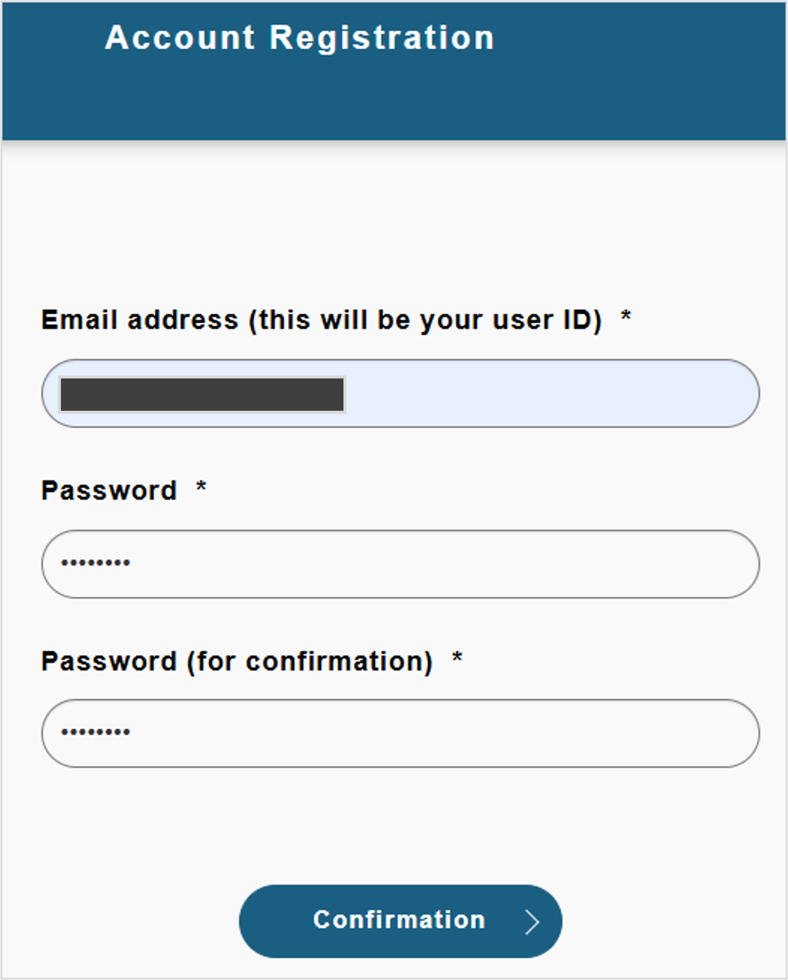
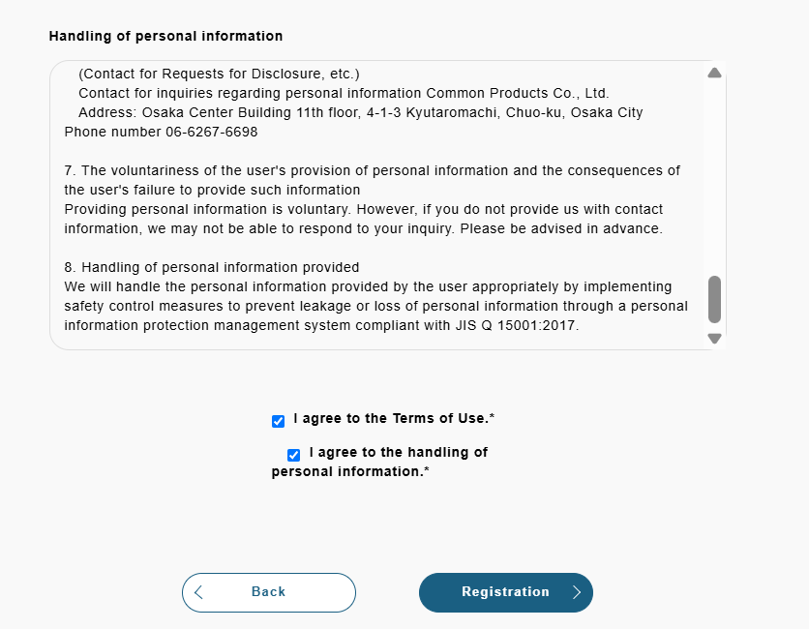
How to Use the Advance Check-in Registration Site
3. On the account registration screen, enter your
email address and password, then tap "Confirm".
4. Review the terms and check each box, then tap "Register".
ｐ.3

Slide 6
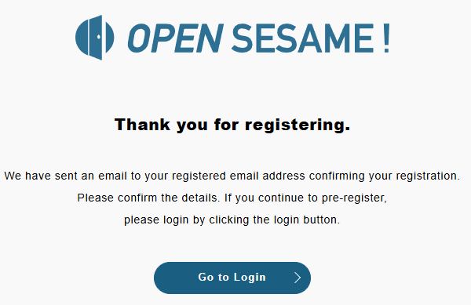
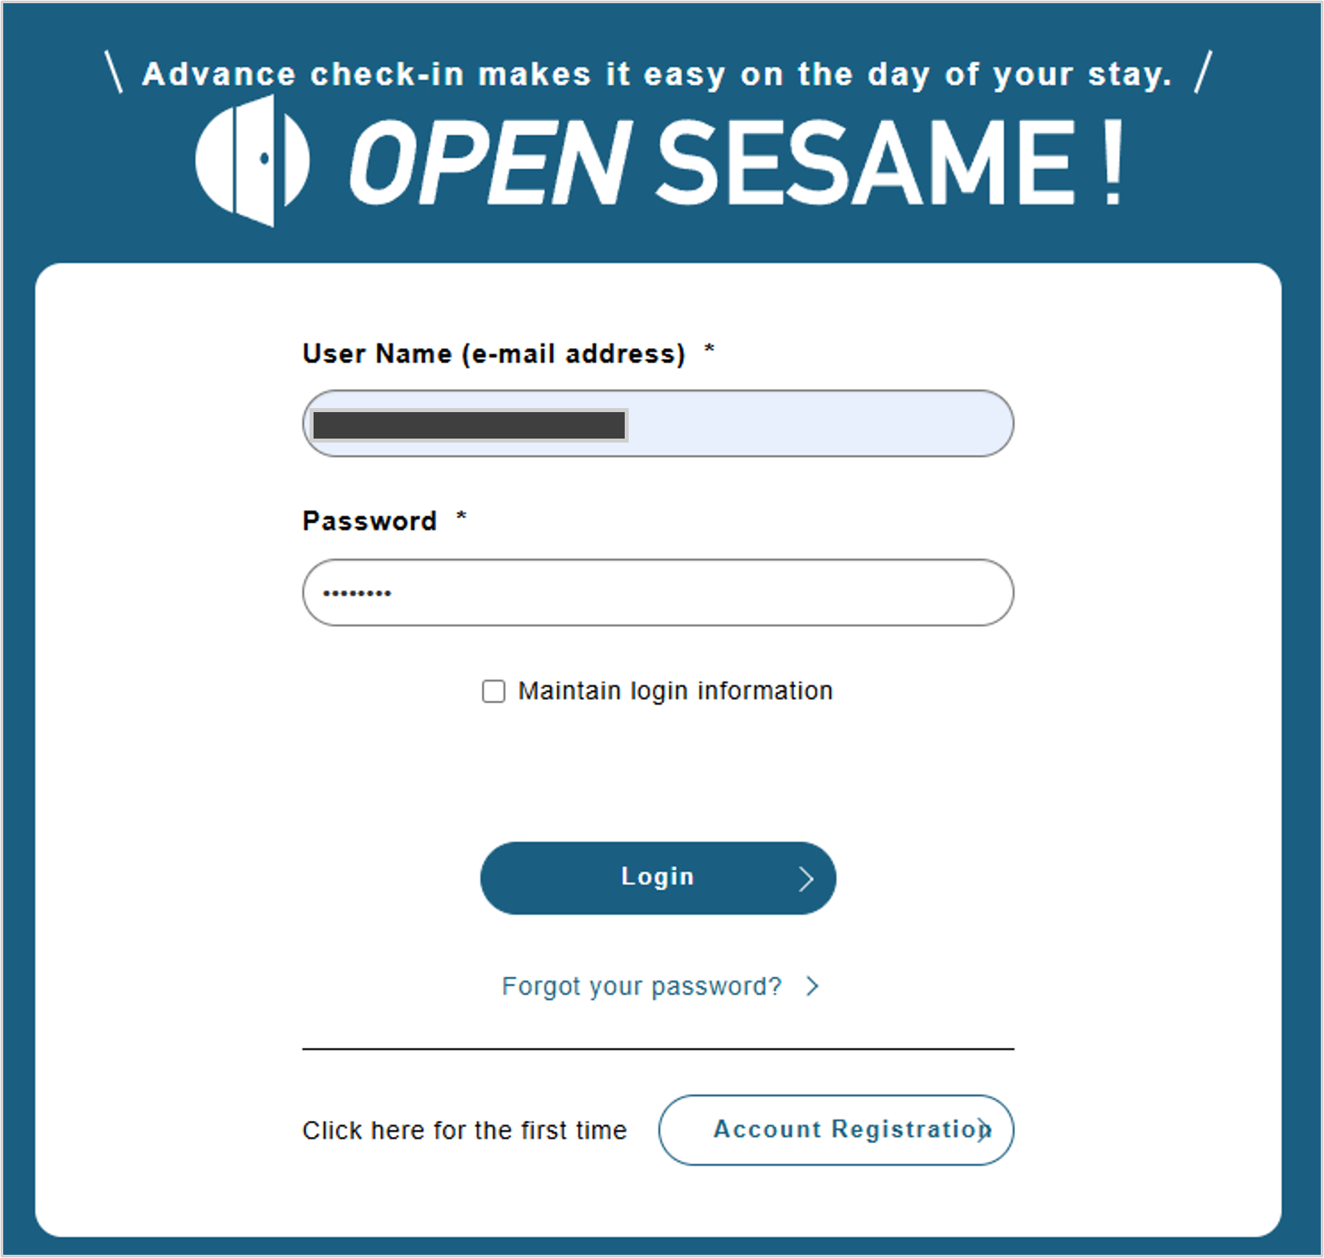
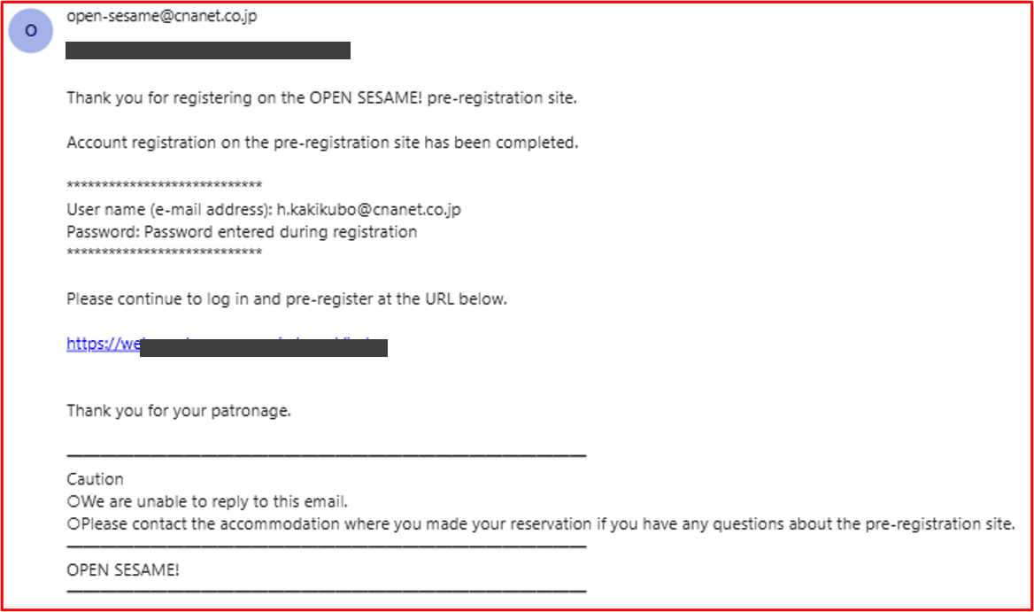
How to Use the Advance Check-in Registration Site
5. After completing account registration,
you will be redirected to the login screen.
6. Log in.
↓Automatically Sent Email
You can also complete your registration via the email.
ｐ.4

Slide 7
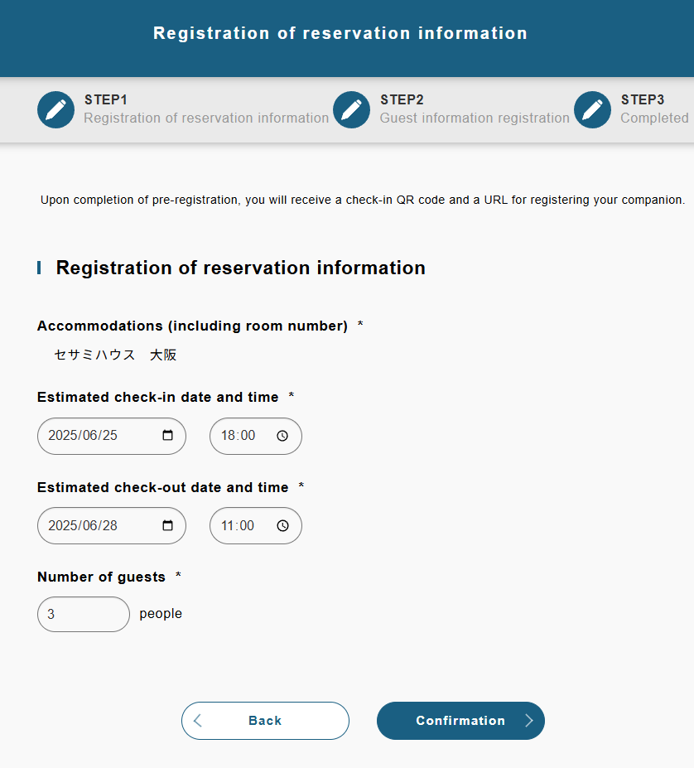
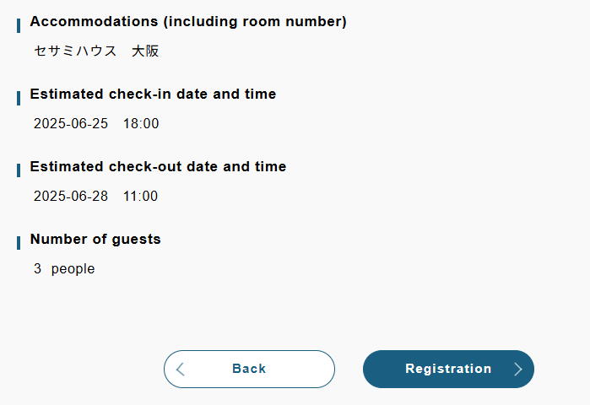
How to Use the Advance Check-in Registration Site
7. Enter the check-in date and the number of guests.
8. On the registration screen, select "Register".
ｐ.5

Slide 8
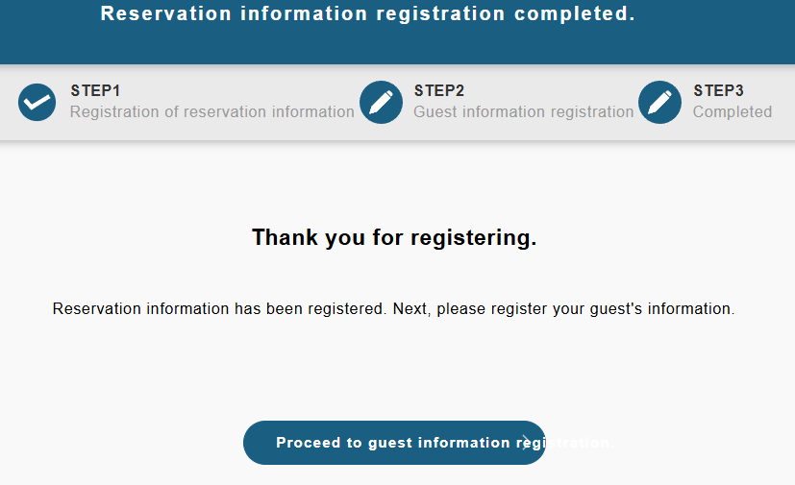
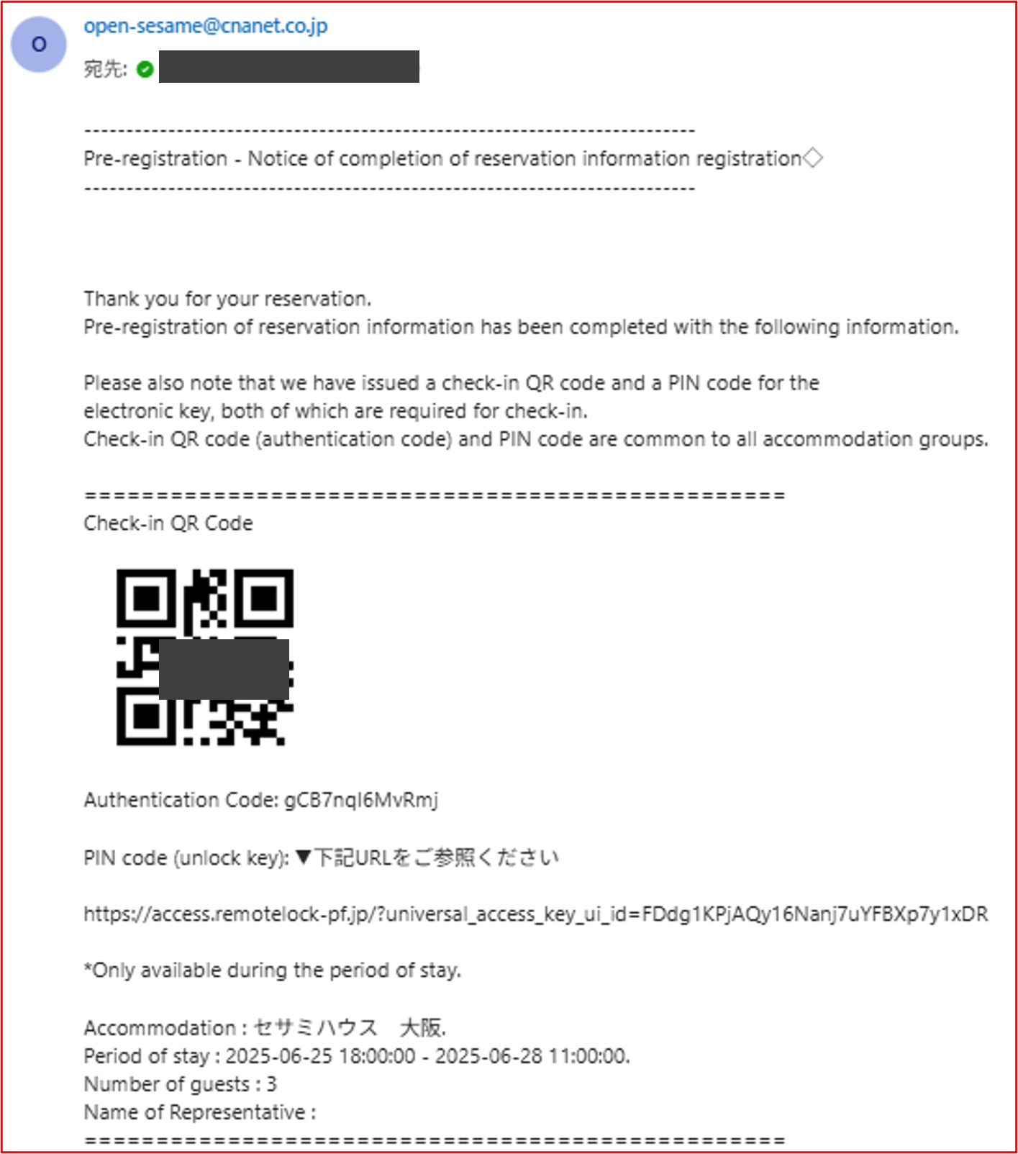
How to Use the Advance Check-in Registration Site
At this stage, an automated email will be sent.However,
please note that this only means you have issued your
reservation — the advance check-in has not yet been
completed.
9. You will be taken to the "Reservation Information Completed" screen.
Next, proceed to register the guest information.
ｐ.6

Slide 9
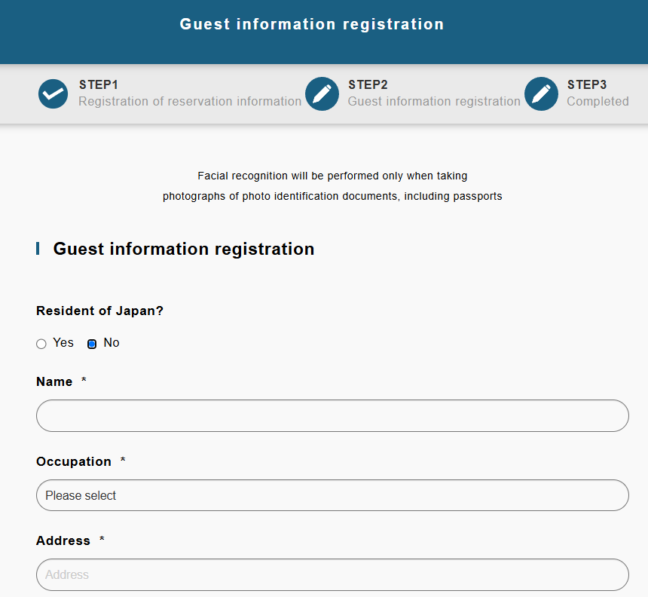
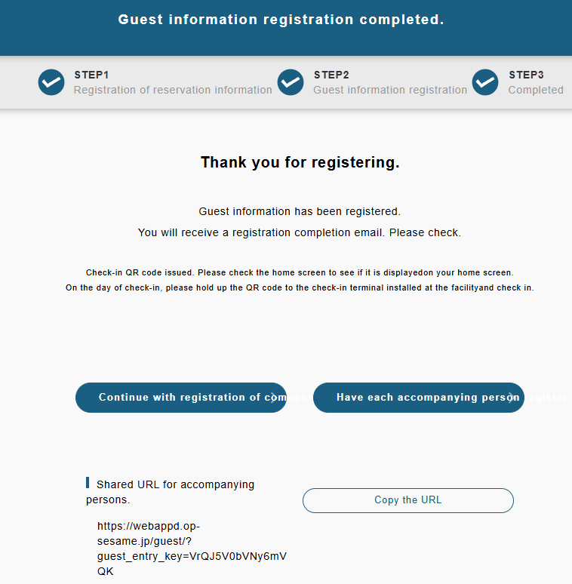
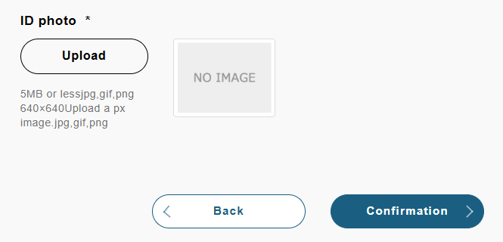
How to Use the Advance Check-in Registration Site
10. After entering your check-in information, tap
"Confirm" and then press "Register".
11. Lead Guest registration is complete. To make additional
selections, please continue. A confirmation email will be sent.
If you do not reside in Japan, please
upload a photo of your passport.
ｐ.7

Slide 10
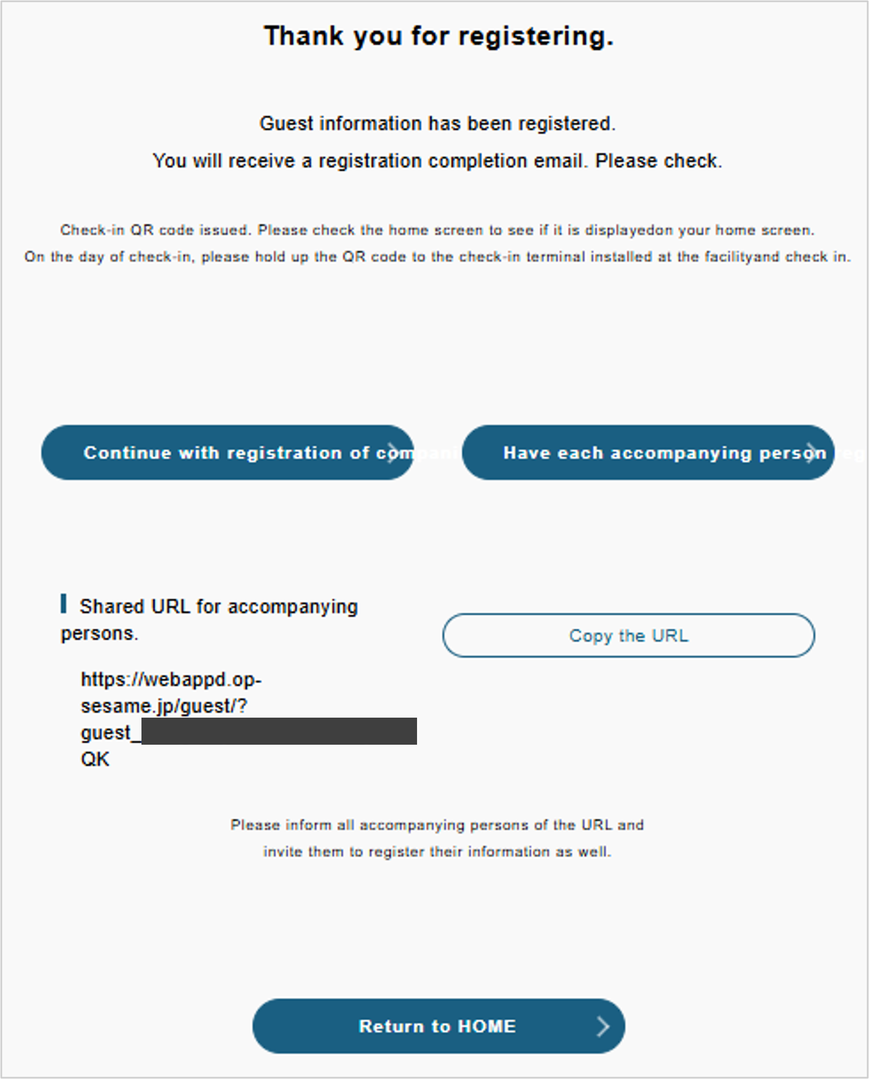

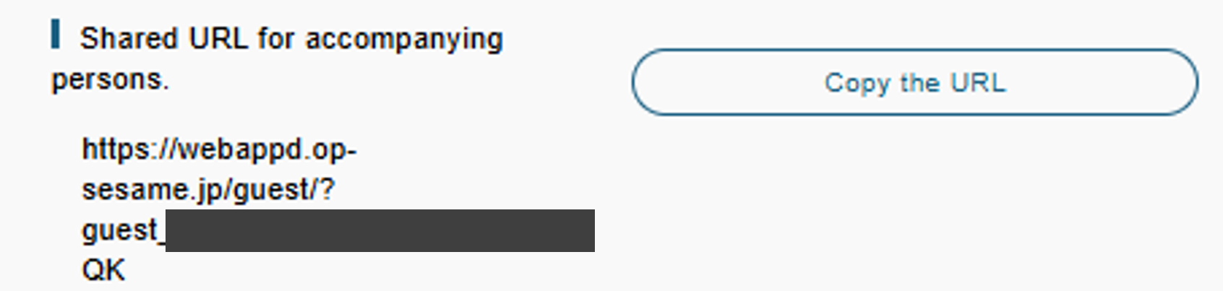

How to Use the Advance Check-in Registration Site
About the Operation Items
To continue entering information for accompanying guests, please select this option.→ See pages 11–12 for details.
If accompanying guests will complete the advance check-in themselves, please select this option.
→ See pages 14–15 for details.
If you are staying alone or wish to finish the process, please select this option and log out.
ｐ.8

Slide 11
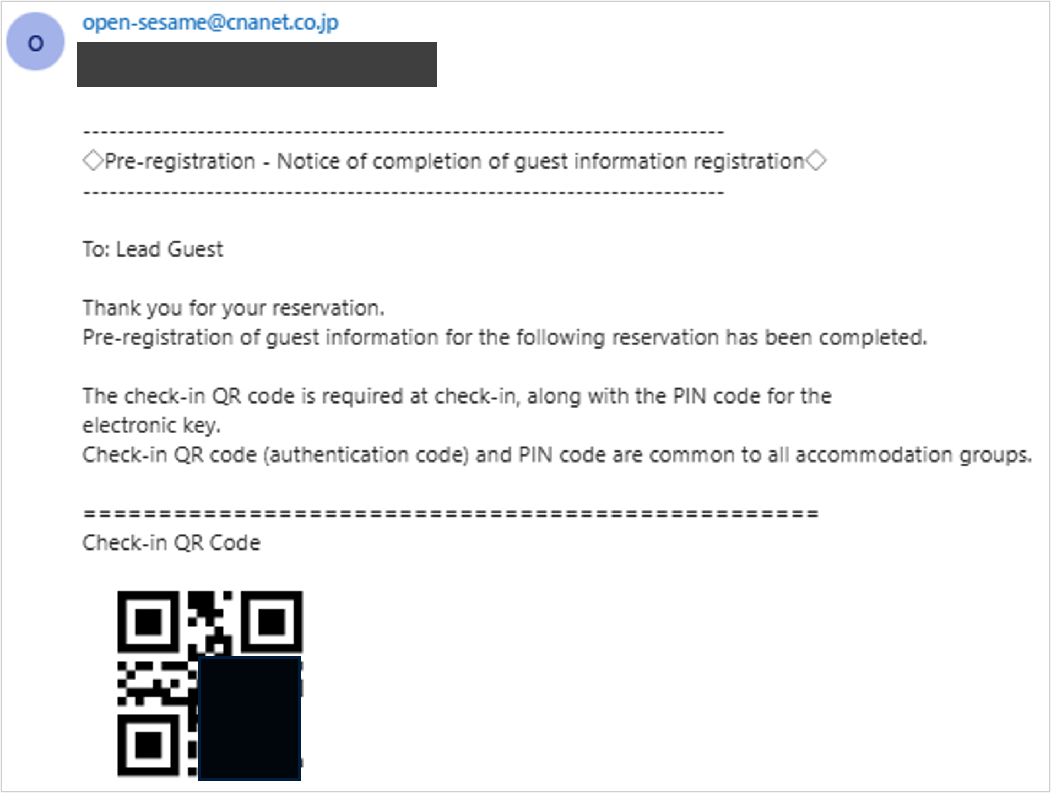
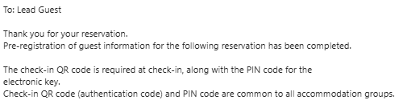
How to Use the Advance Check-in Registration Site
事前登録完了後のメールについて
登録が完了すると事前登録完了メールが送信されるので、当日はそちらのメールを利用し入室後、チェックインを行います。
After entering the room, hold the QR code over the check-in tablet.
ｐ.9

Slide 12
If you wish to continue registering
information for accompanying guests
ｐ.10

Slide 13
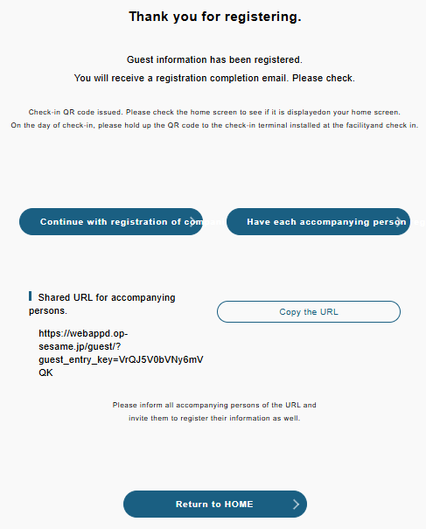
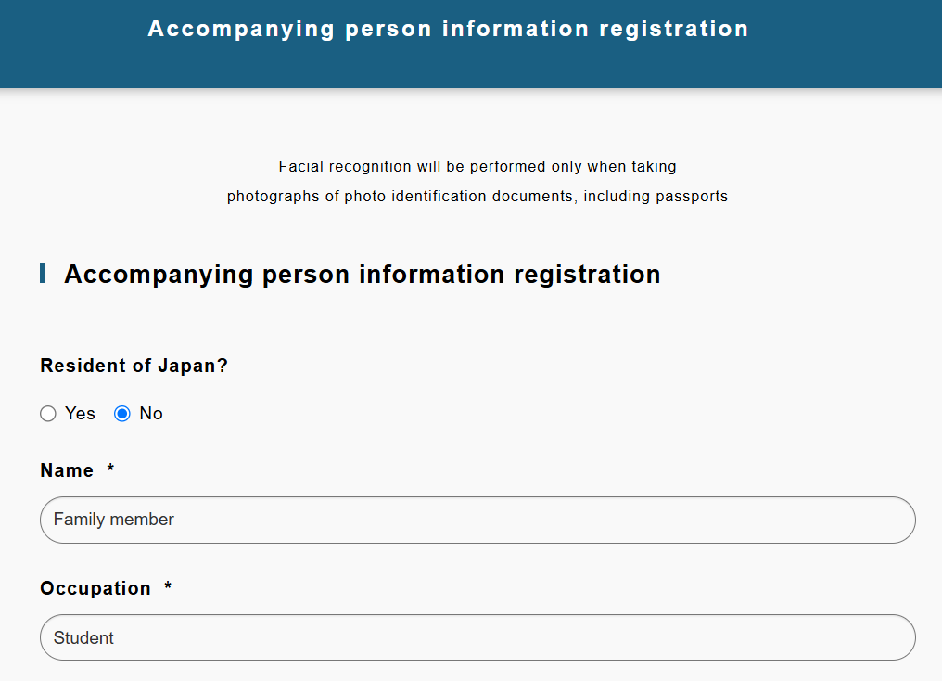
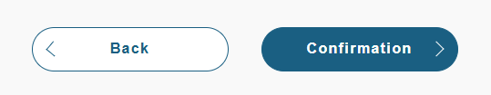
How to Use the Advance Check-in Registration Site
If you wish to continue registering information for accompanying guests
1.Select "Continue with registration of companion information".
2.Enter the companion's information, review the details,
and then press "Register".
ｐ.11

Slide 14
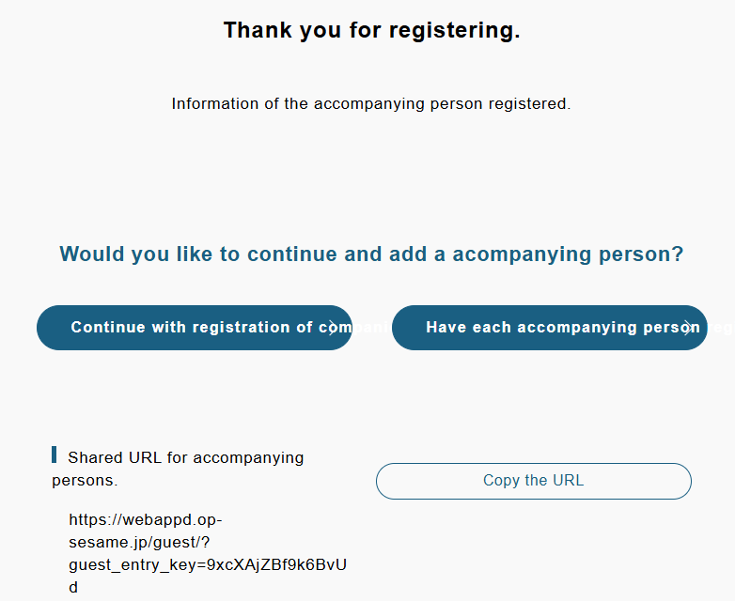
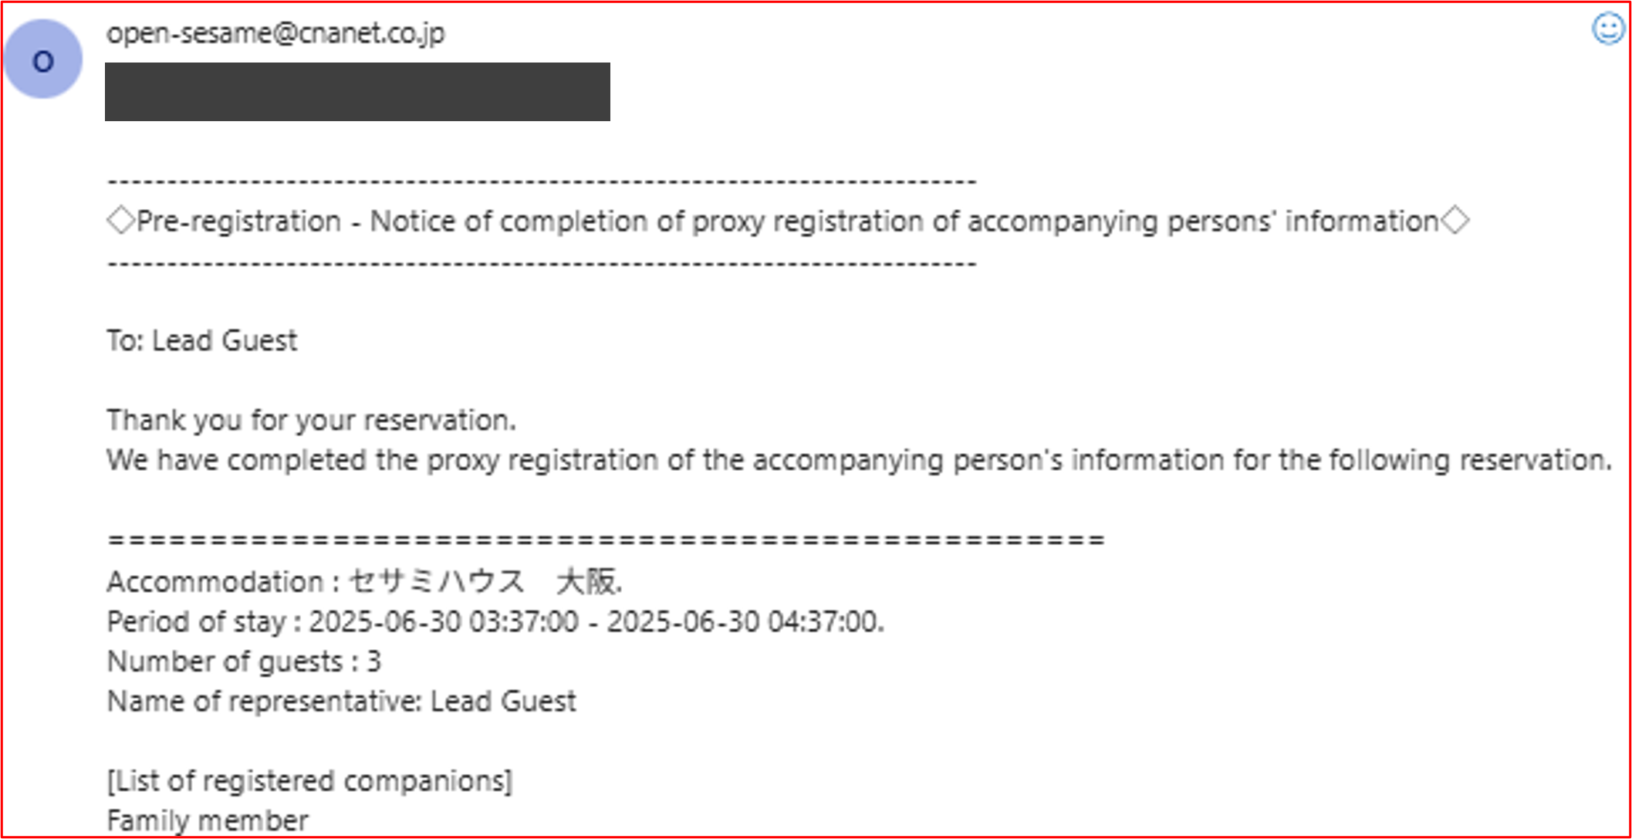
How to Use the Advance Check-in Registration Site
If you wish to continue registering information for accompanying guests
3.This completes the registration of the companion's information.After completion,
a confirmation email will be sent to the Lead Guest notifying that the companion’s
information has been registered on their behalf.
↓Companion Information Registration Completed
ｐ.12

Slide 15
If each companion will
complete their own registration
ｐ.13

Slide 16
How to Use the Advance Check-in Registration Site
If each companion will complete their own registration
1. Tap "Copy the URL" to copy the link.
2. The Lead Guest should send the copied URL for companion
registration via email or SNS. This URL can also be shared
between companions if needed.
Lead Guest
Accompanying Guest
Accompanying Guest
ｐ.14

Slide 17
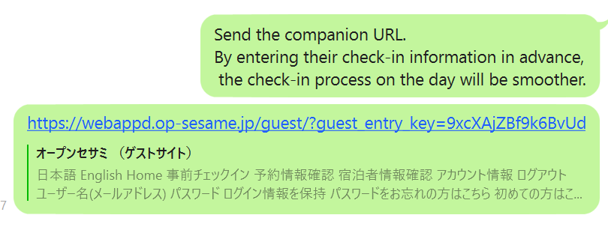
How to Use the Advance Check-in Registration Site
If each companion will complete their own registration
3. The accompanying guest should click the URL
they received or enter it into their browser.
2. Log in to the system.When you open the URL, if the
language is displayed in Japanese, click “言語選択”
at the top right and switch it to English.
01
02
If the language is set to Japanese,
select option ① and change it to English.
ｐ.15

Slide 18
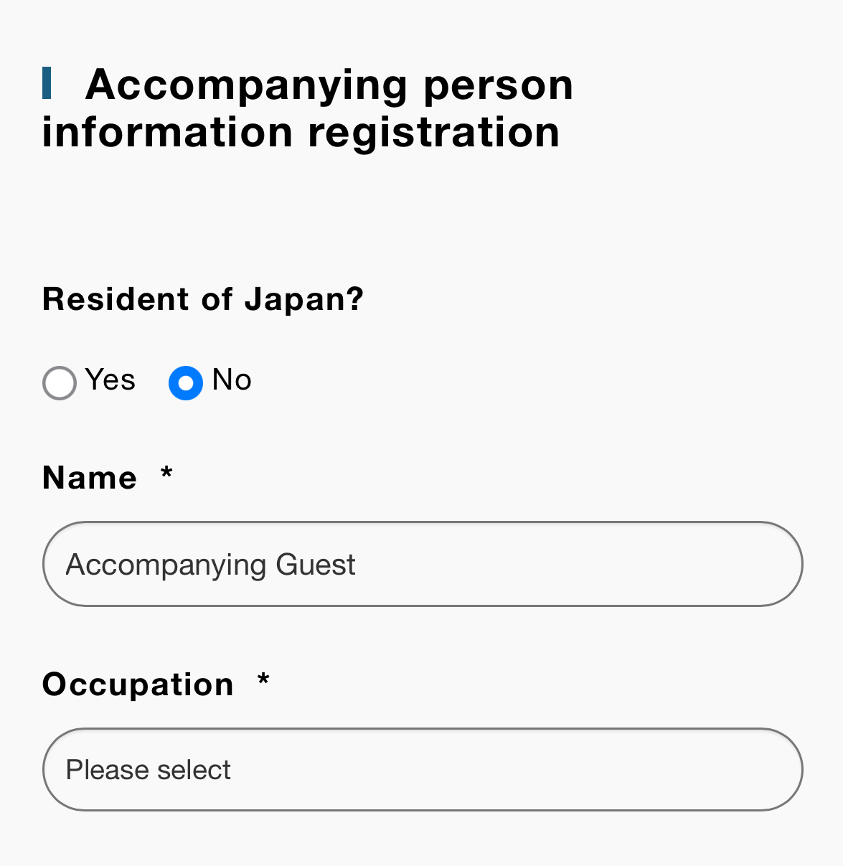
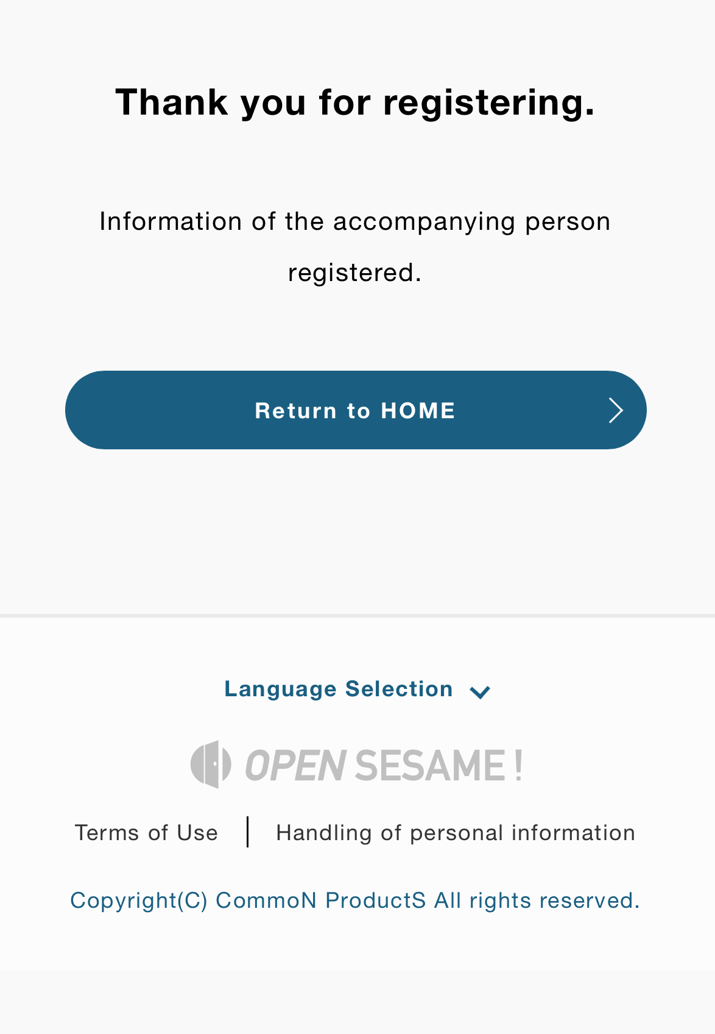
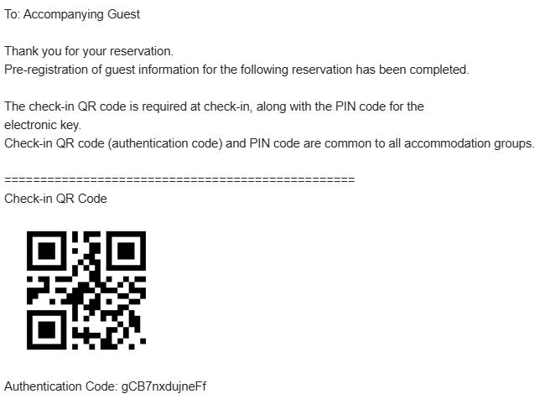
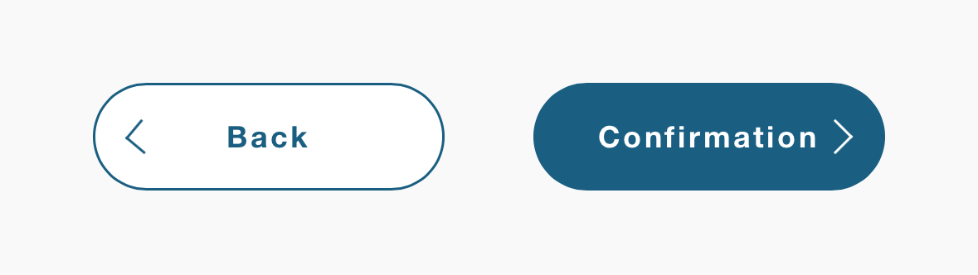
How to Use the Advance Check-in Registration Site
If each companion will complete their own registration
3. After logging in, you will be directed to the companion
information registration screen. Enter the accommodation
details, then confirm and complete the registration.
4. Once the companion information registration completion screen
appears, the process is complete. A confirmation email will also
be sent to the companion upon successful registration.
↓Email that will be sent
ｐ.16

Slide 19
About Check-in
ｐ.17

Slide 20

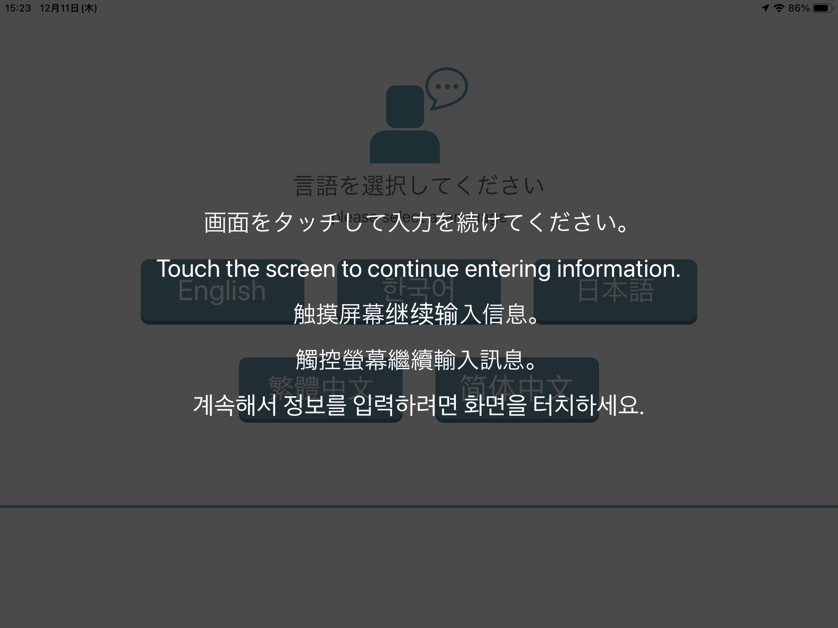
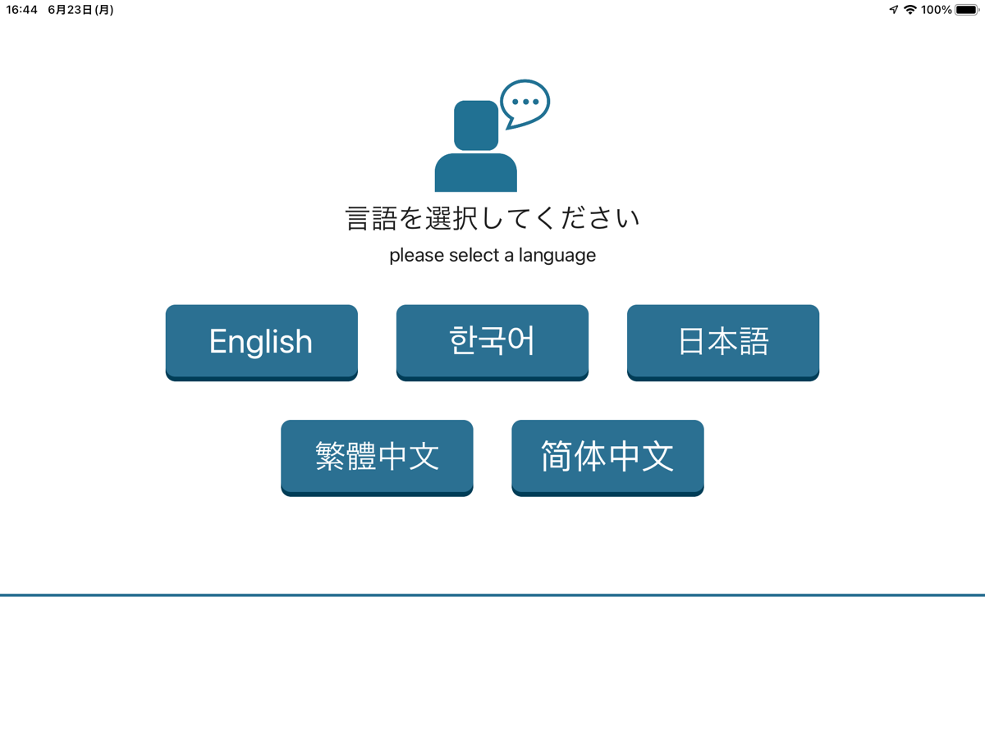
About Check-in
1. After entering the accommodation, operate the check-in terminal.
The screen may appear dim, so touch the screen to begin operation.
2. Select a language and start the check-in process.
※ Even if the “Check Out” button is displayed on the screen,
you can proceed with check-in by selecting a language.
Therefore, even if members of the same group enter the
accommodation at different times,
each person can still complete the check-in process.
ｐ.18

Slide 21
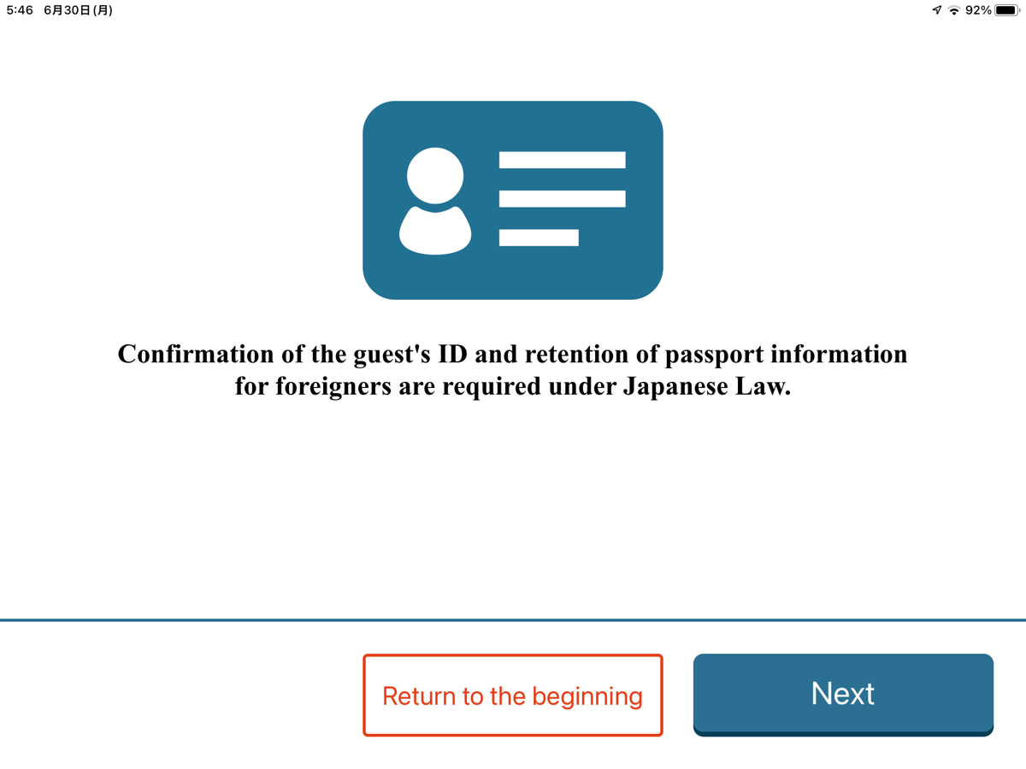
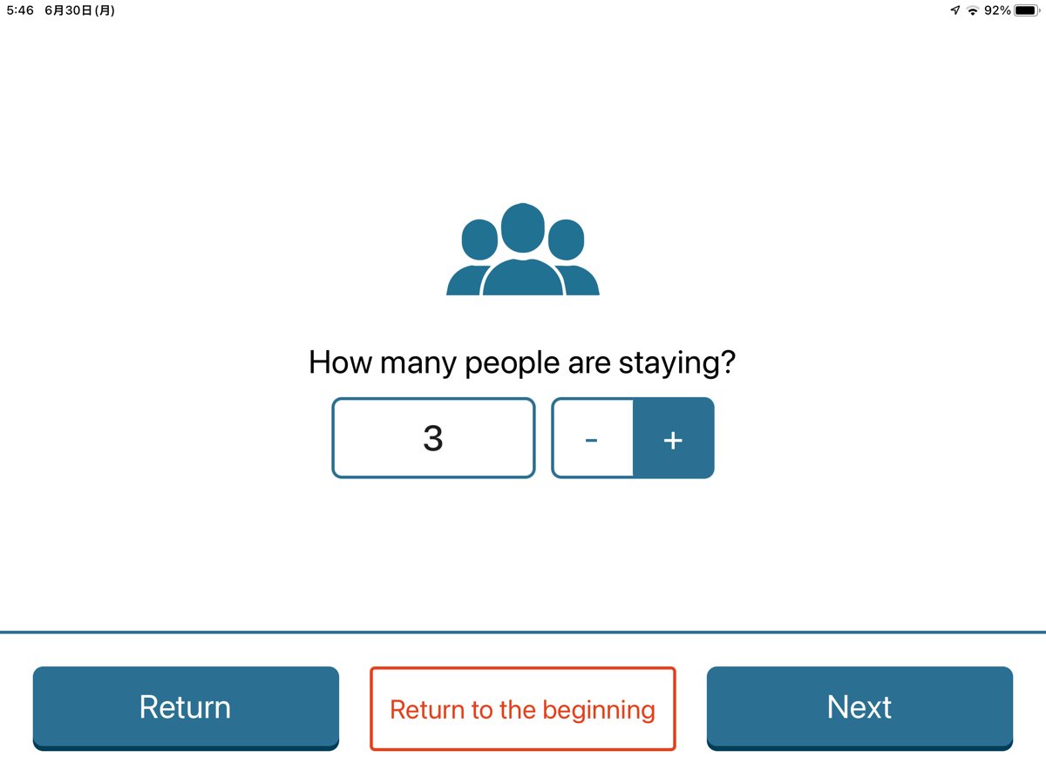
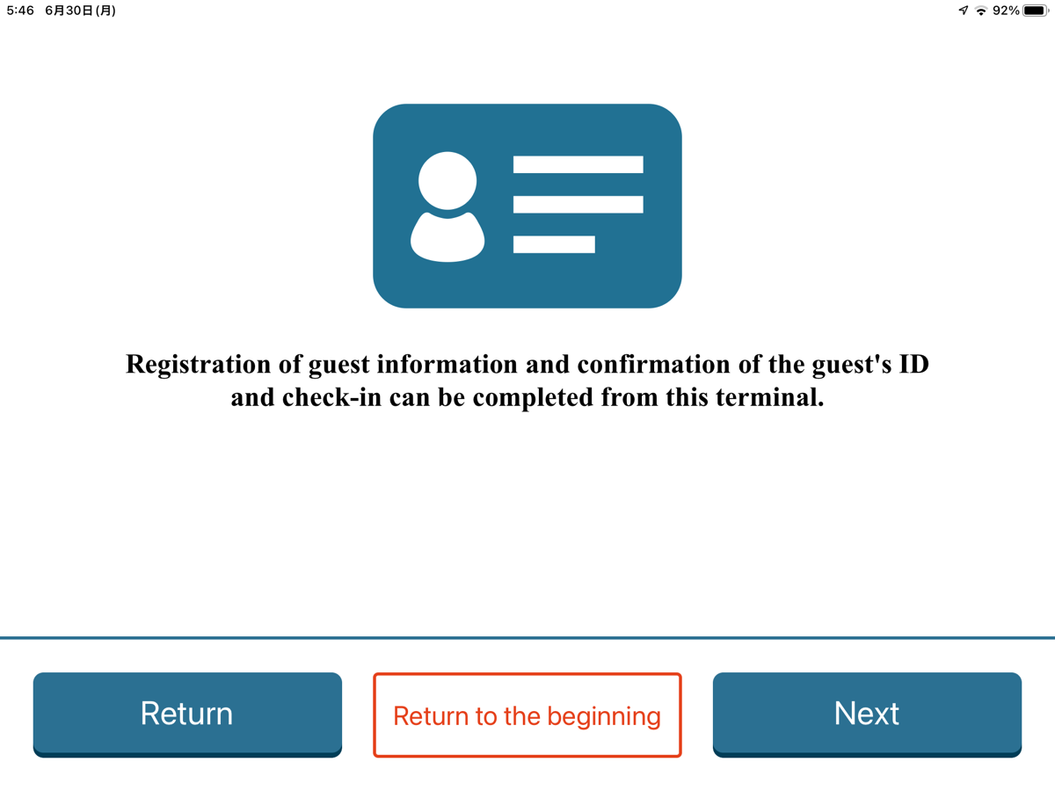
About Check-in
3. Please read the legal information provided,
then tap "Next" to continue.
4. Select the number of guests staying, then tap "Next".
01
02
ｐ.19

Slide 22
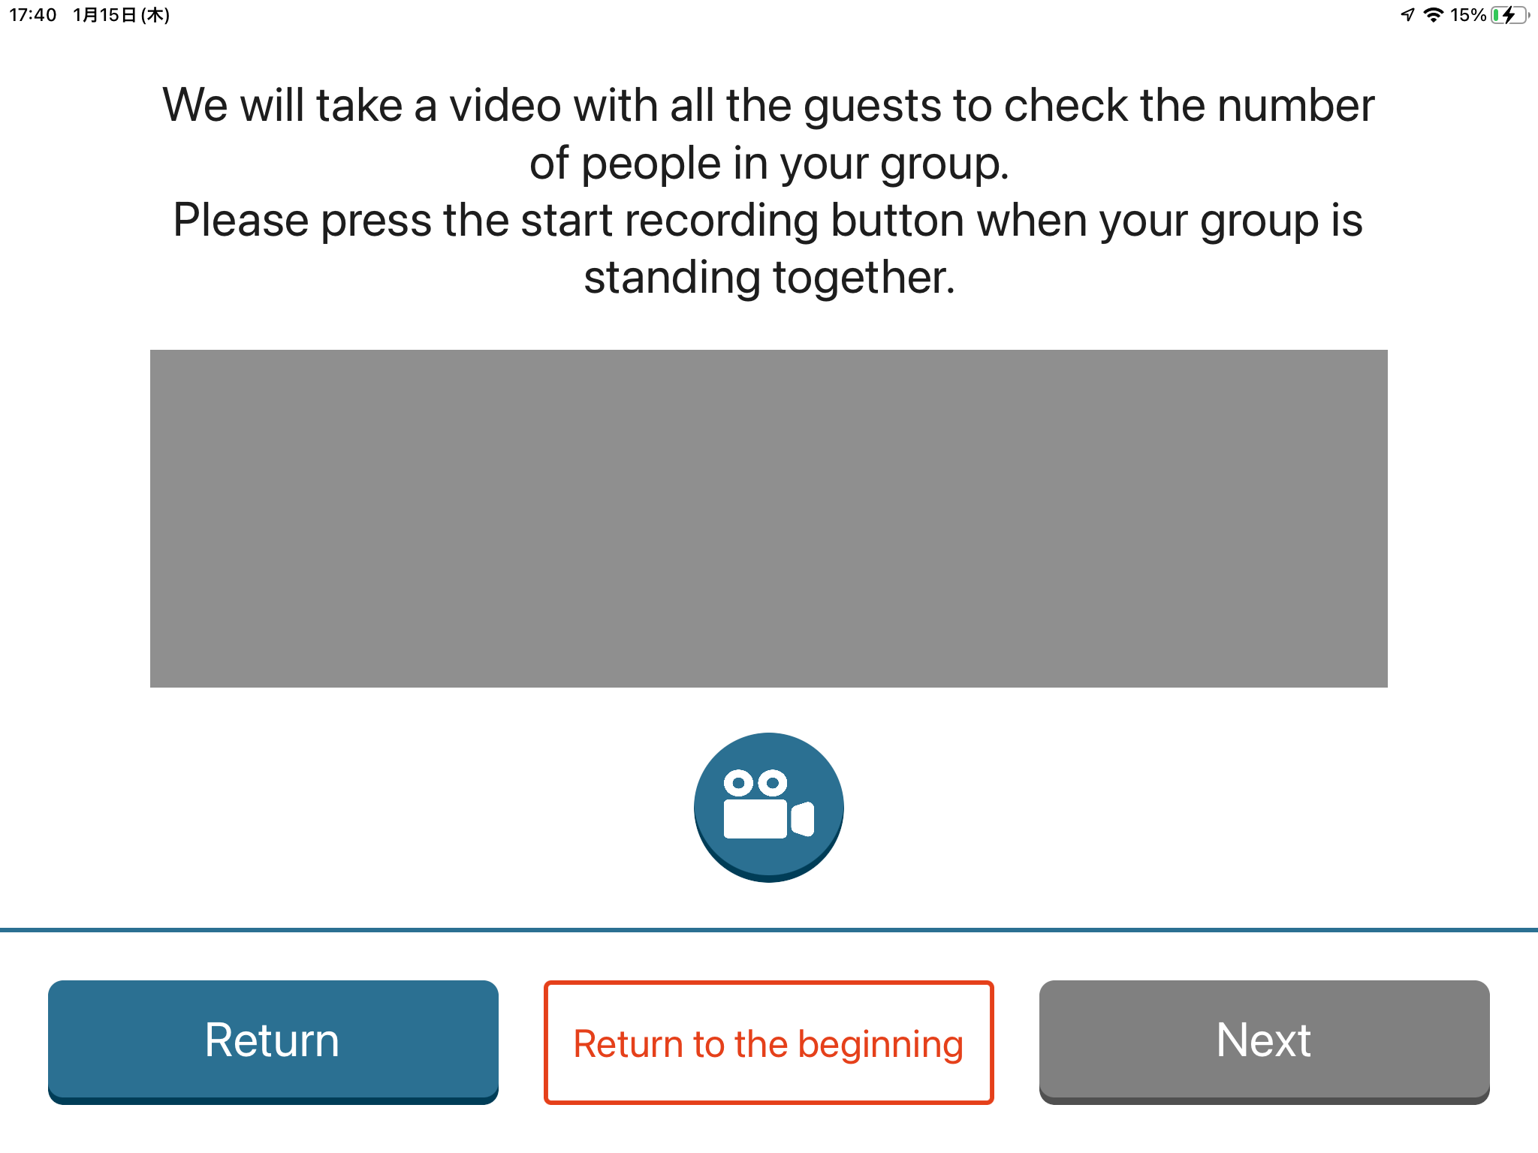
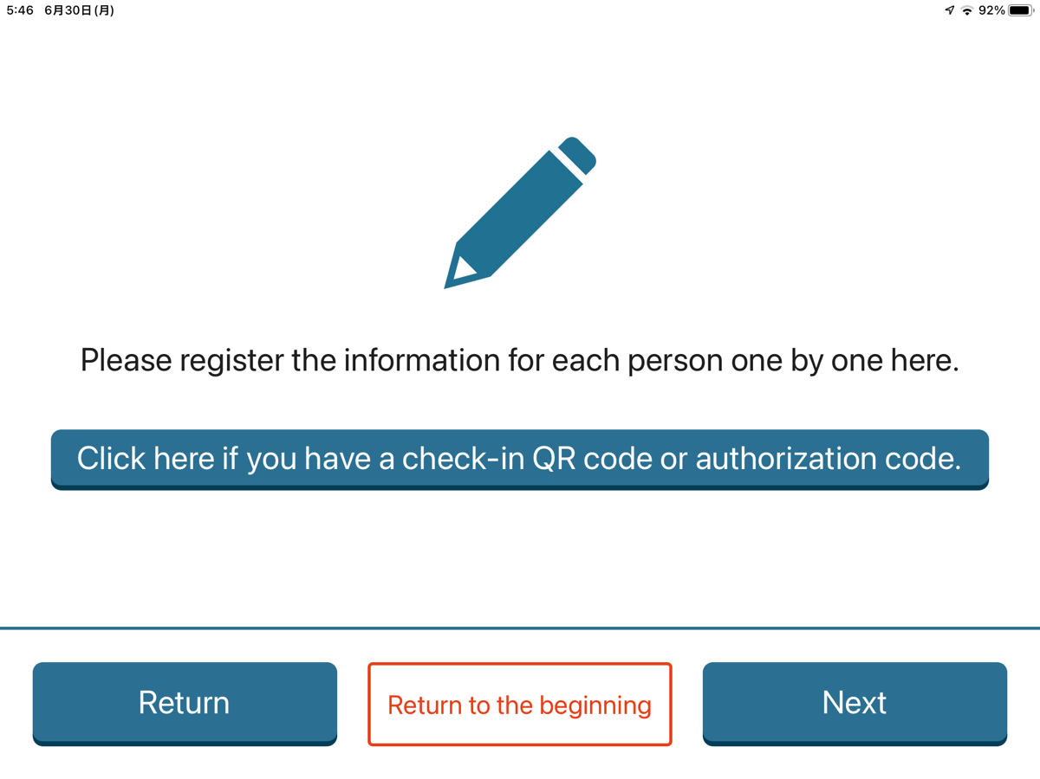
About Check-in
5. If video recording is required, press the “Camera” button
and record a video of approximately 5 seconds.
6. Guests who have completed advance registration
should select the option related to the QR code.
Depending on the facility, video recording may be required for
security purposes.If video recording is not required, proceed
directly to Step 6.
If you do not have one, select “Next.”
ｐ.20

Slide 23
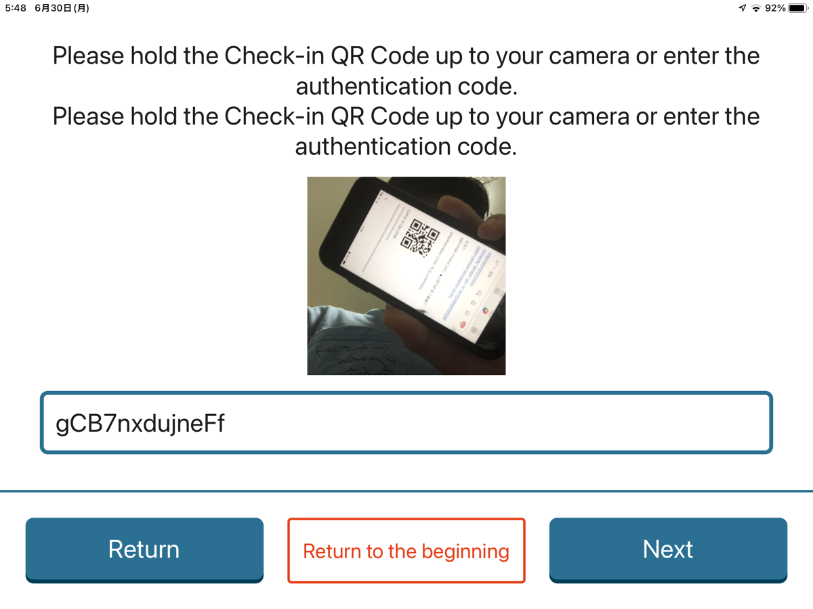
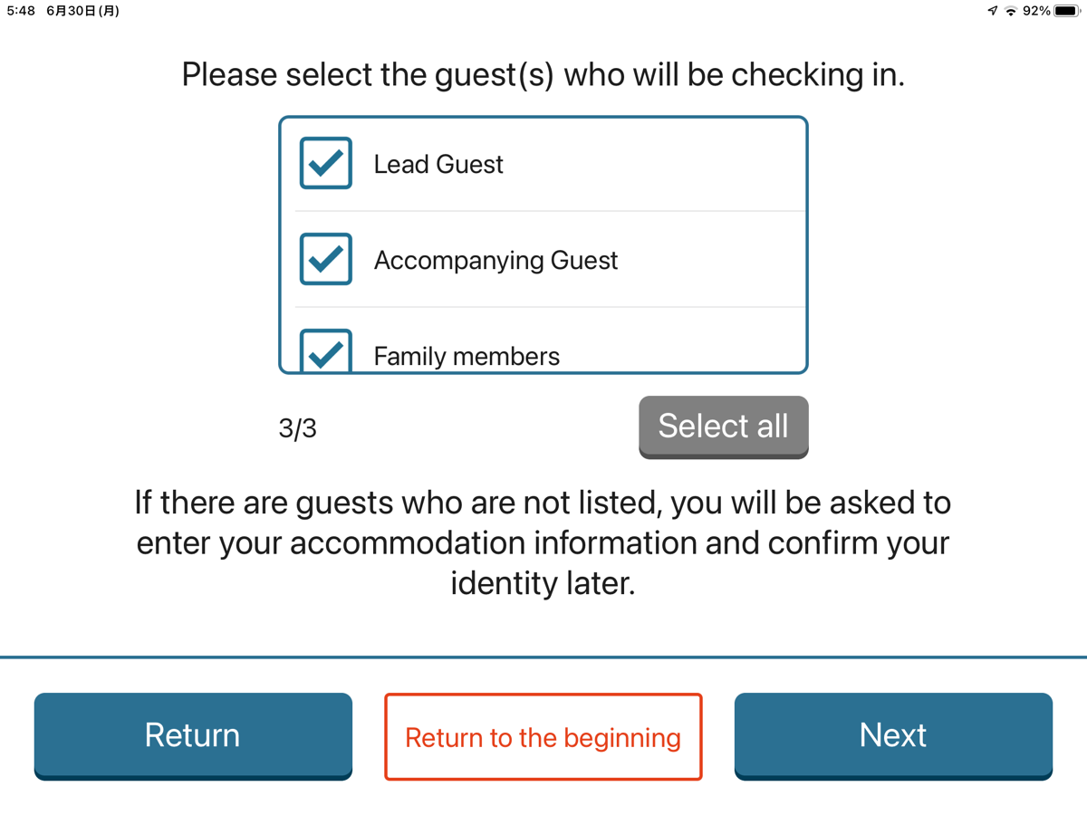
About Check-in
7. Hold the QR code shown in the email you received
during advance registration over the scanner.
8. Select the guest who will check in, then select “Next.”
If the QR code cannot be read successfully,
enter the authentication code.
ｐ.21

Slide 24
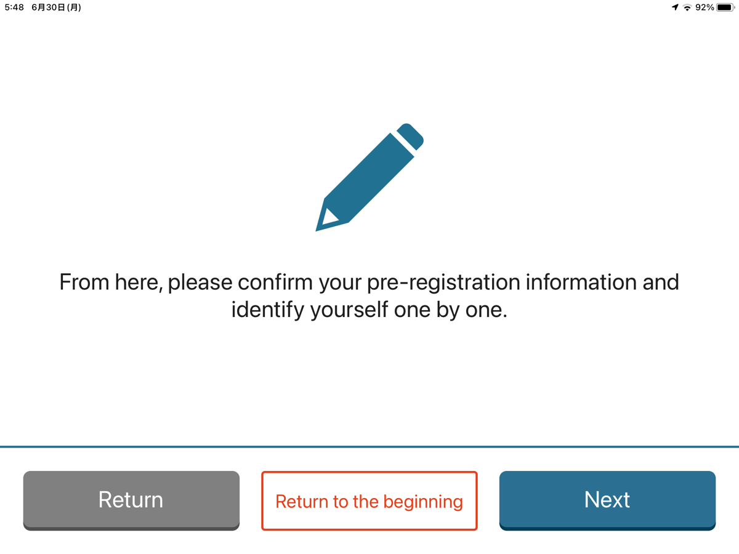
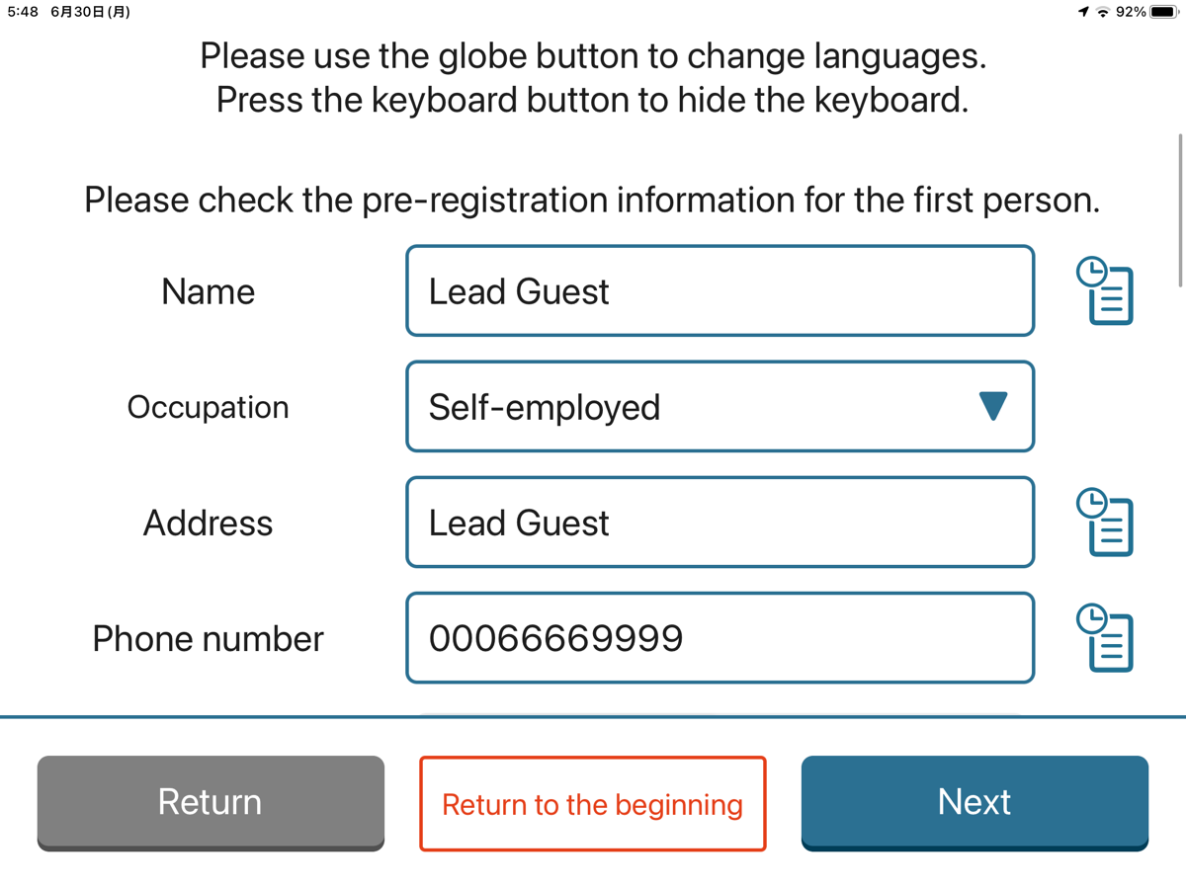
About Check-in
9. To verify the identity of the selected guest, press “Next.”
10. The information registered during advance registration
will be displayed. Please check that the details are correct,
then press “Next.”
If the passport photo registered on the advance
registration site is blurry,or if a document other
than an official ID with a facial photo was uploaded,
you may be asked to take the photo again.
ｐ.22

Slide 25
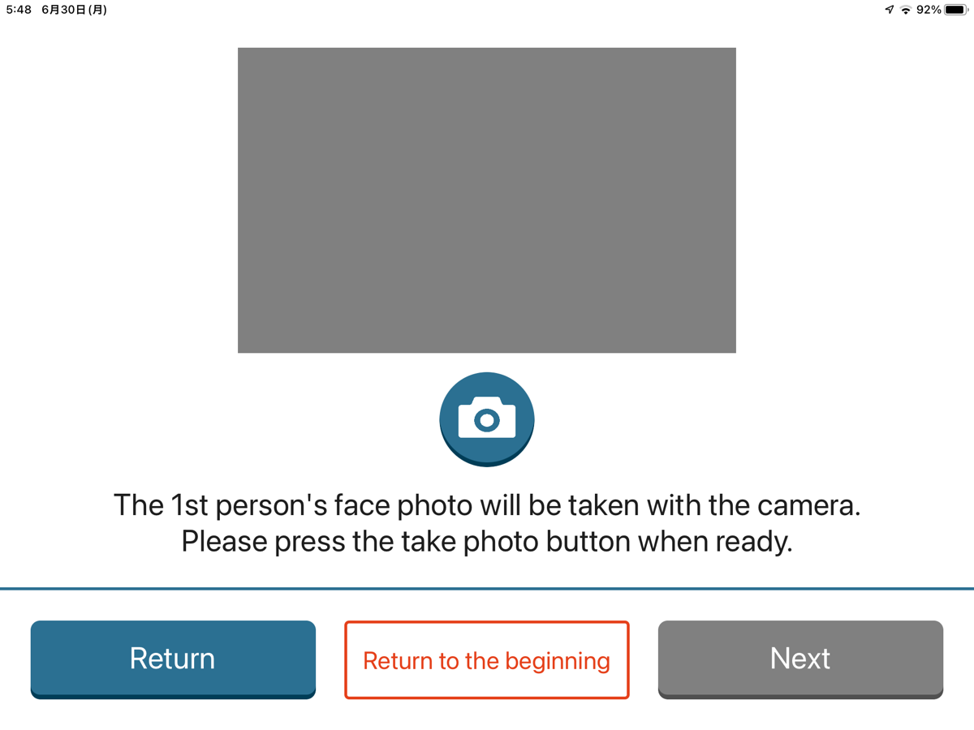
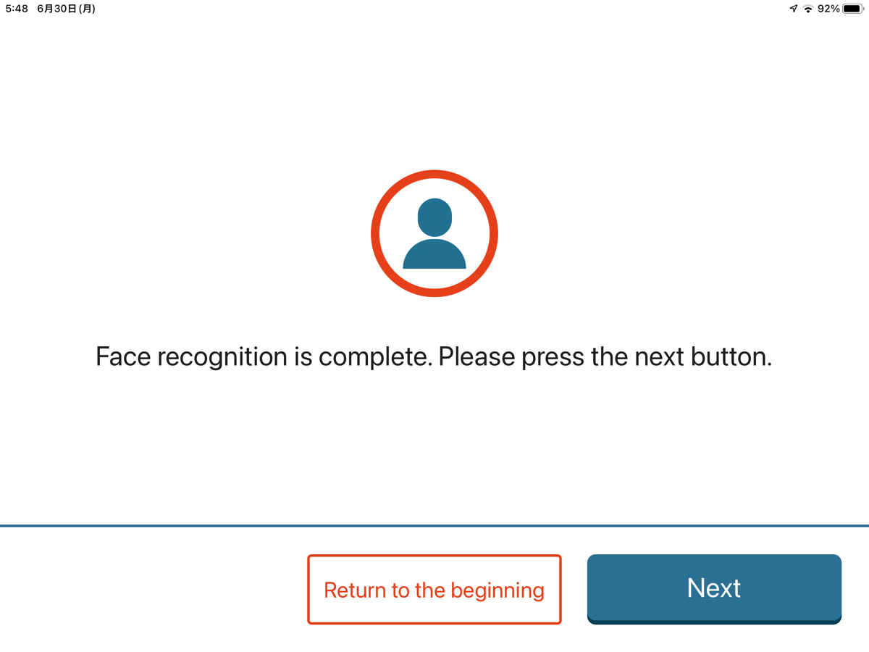
About Check-in
11. To link the guest’s information with their facial
photo, take a photo.Press the camera icon in the
center to capture the photo, then press “Next.”
12. Once facial photo capture for all guests is complete,
the screen will transition to this page.Press “Next.”
Repeat Steps 10 to 12 until the process is
completed for all guests.
ｐ.23

Slide 26
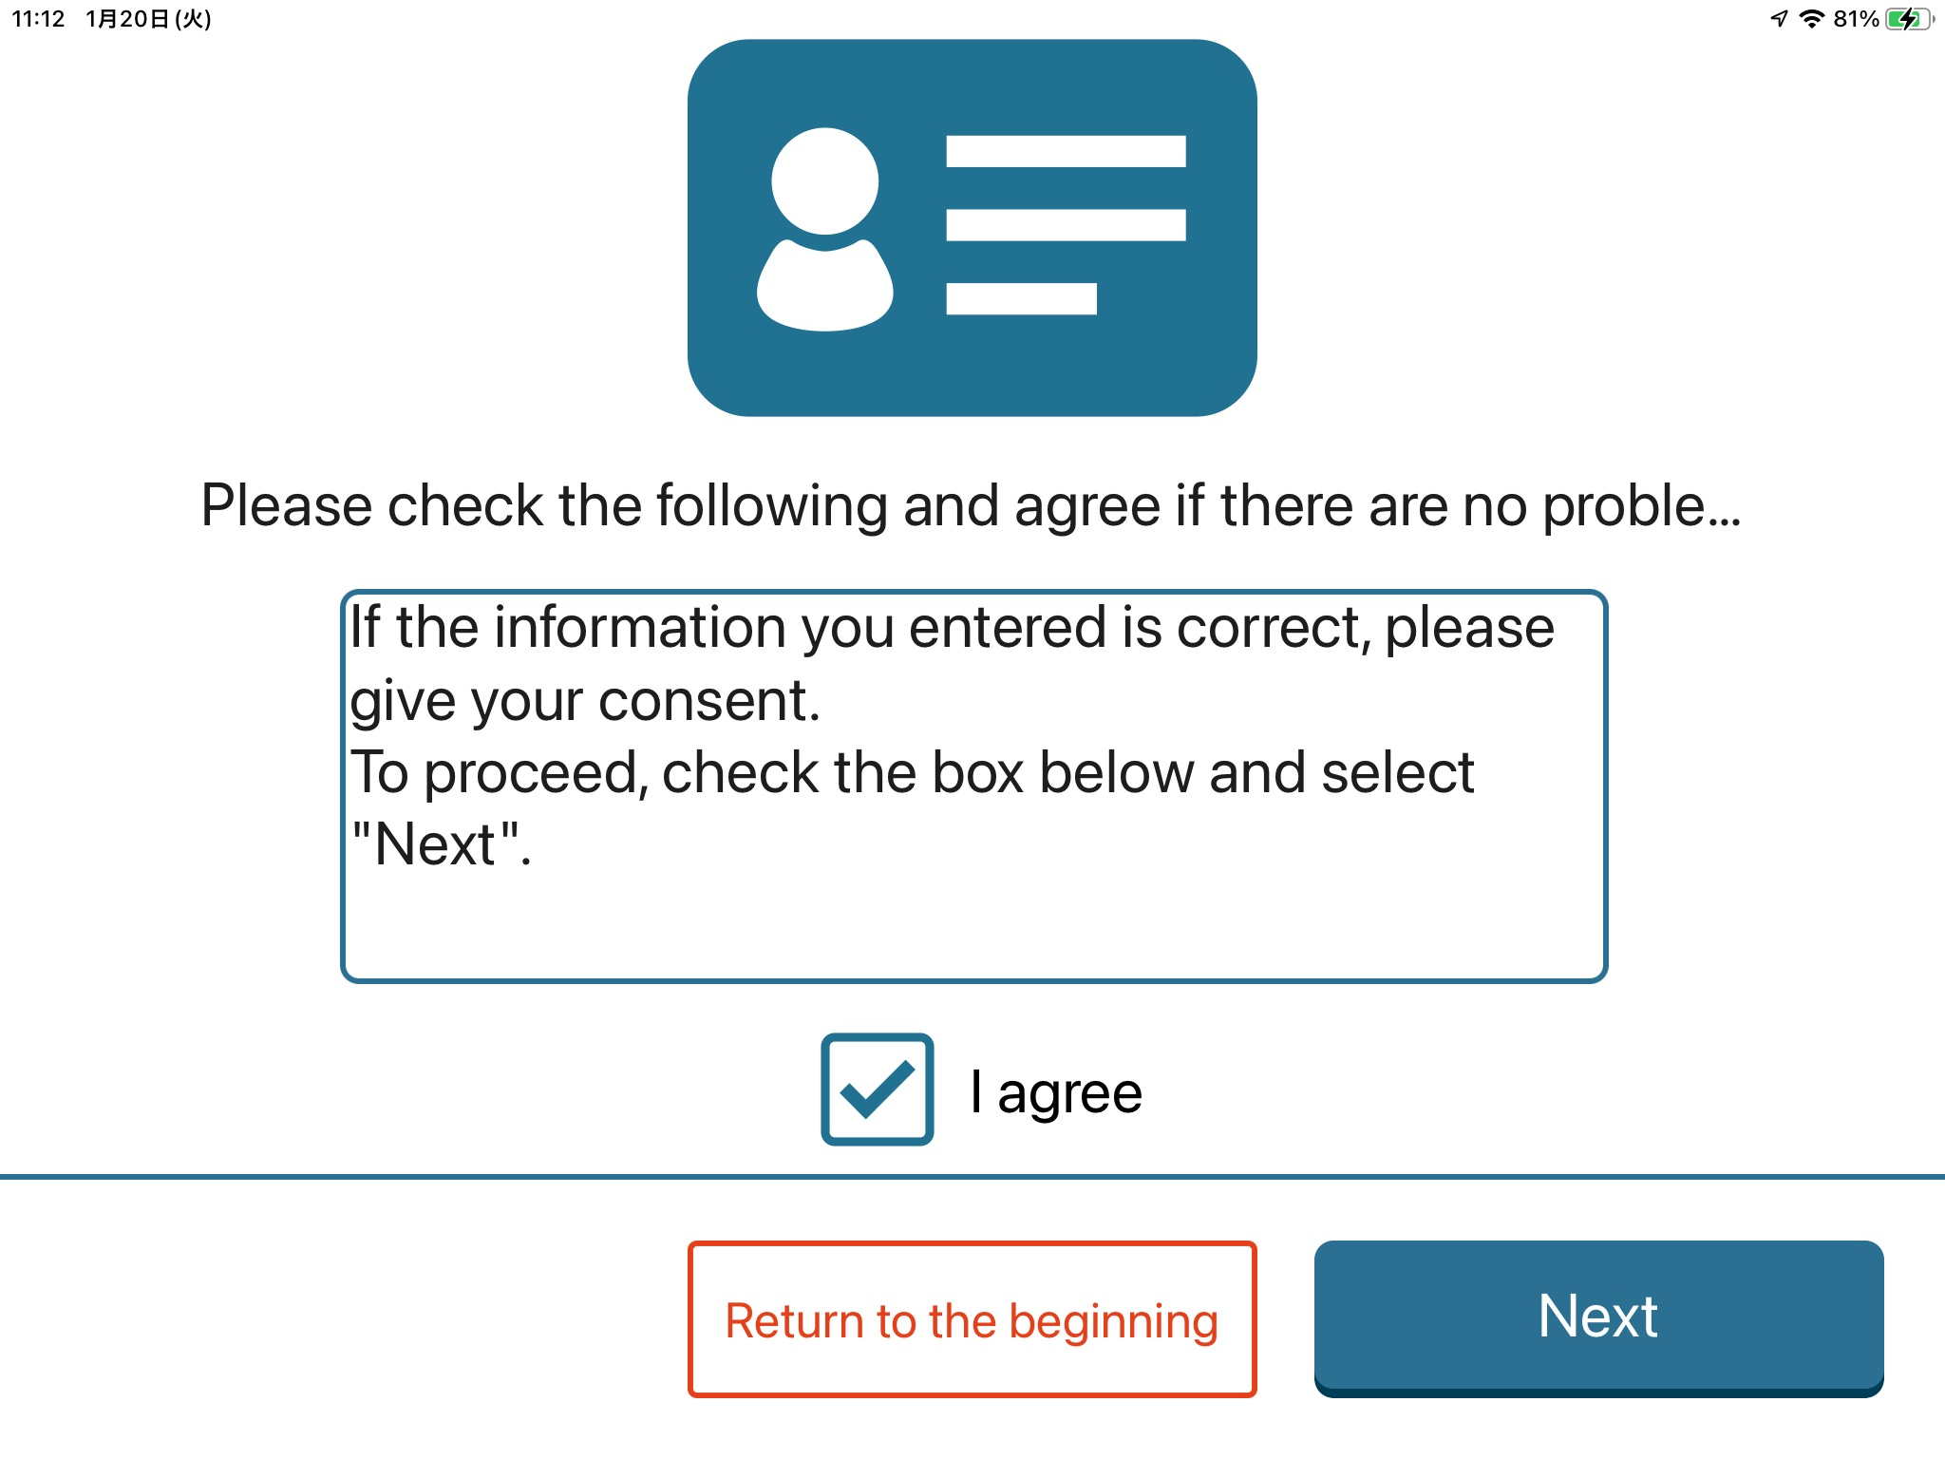
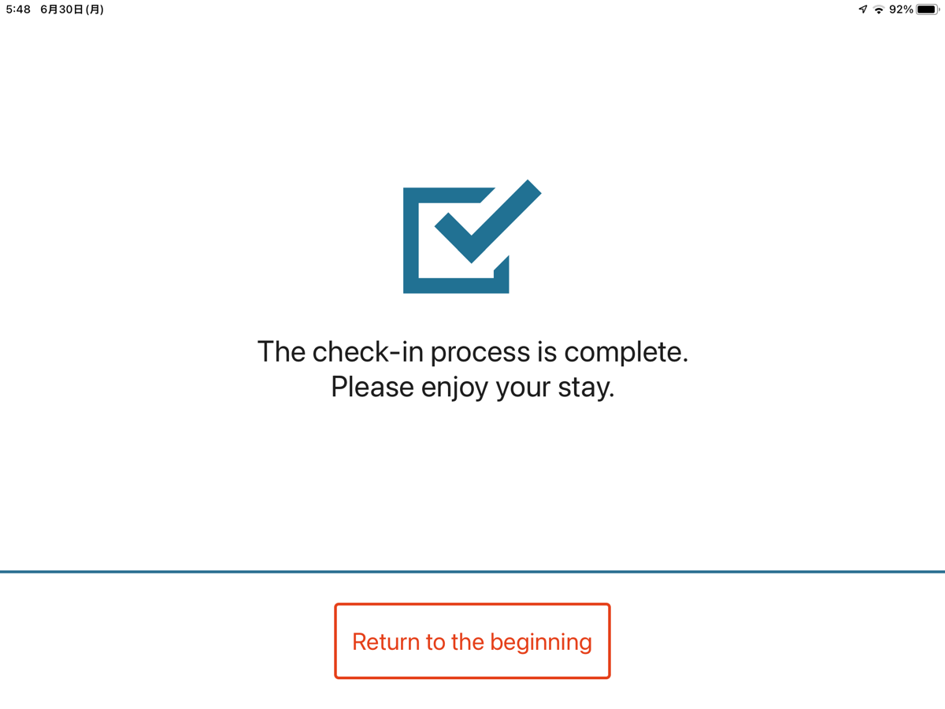
About Check-in
13. If a checkbox is displayed, review the contents,
tap the checkbox, and select “Next.”
14. Check-in is complete. You may leave the screen as it is,
or press “Return to Start.”
Depending on the facility, a checkbox may be provided for security
reasons. If no checkbox is displayed, proceed directly to Step 14.
ｐ.24

Slide 27
About Check-out
ｐ.25

Slide 28
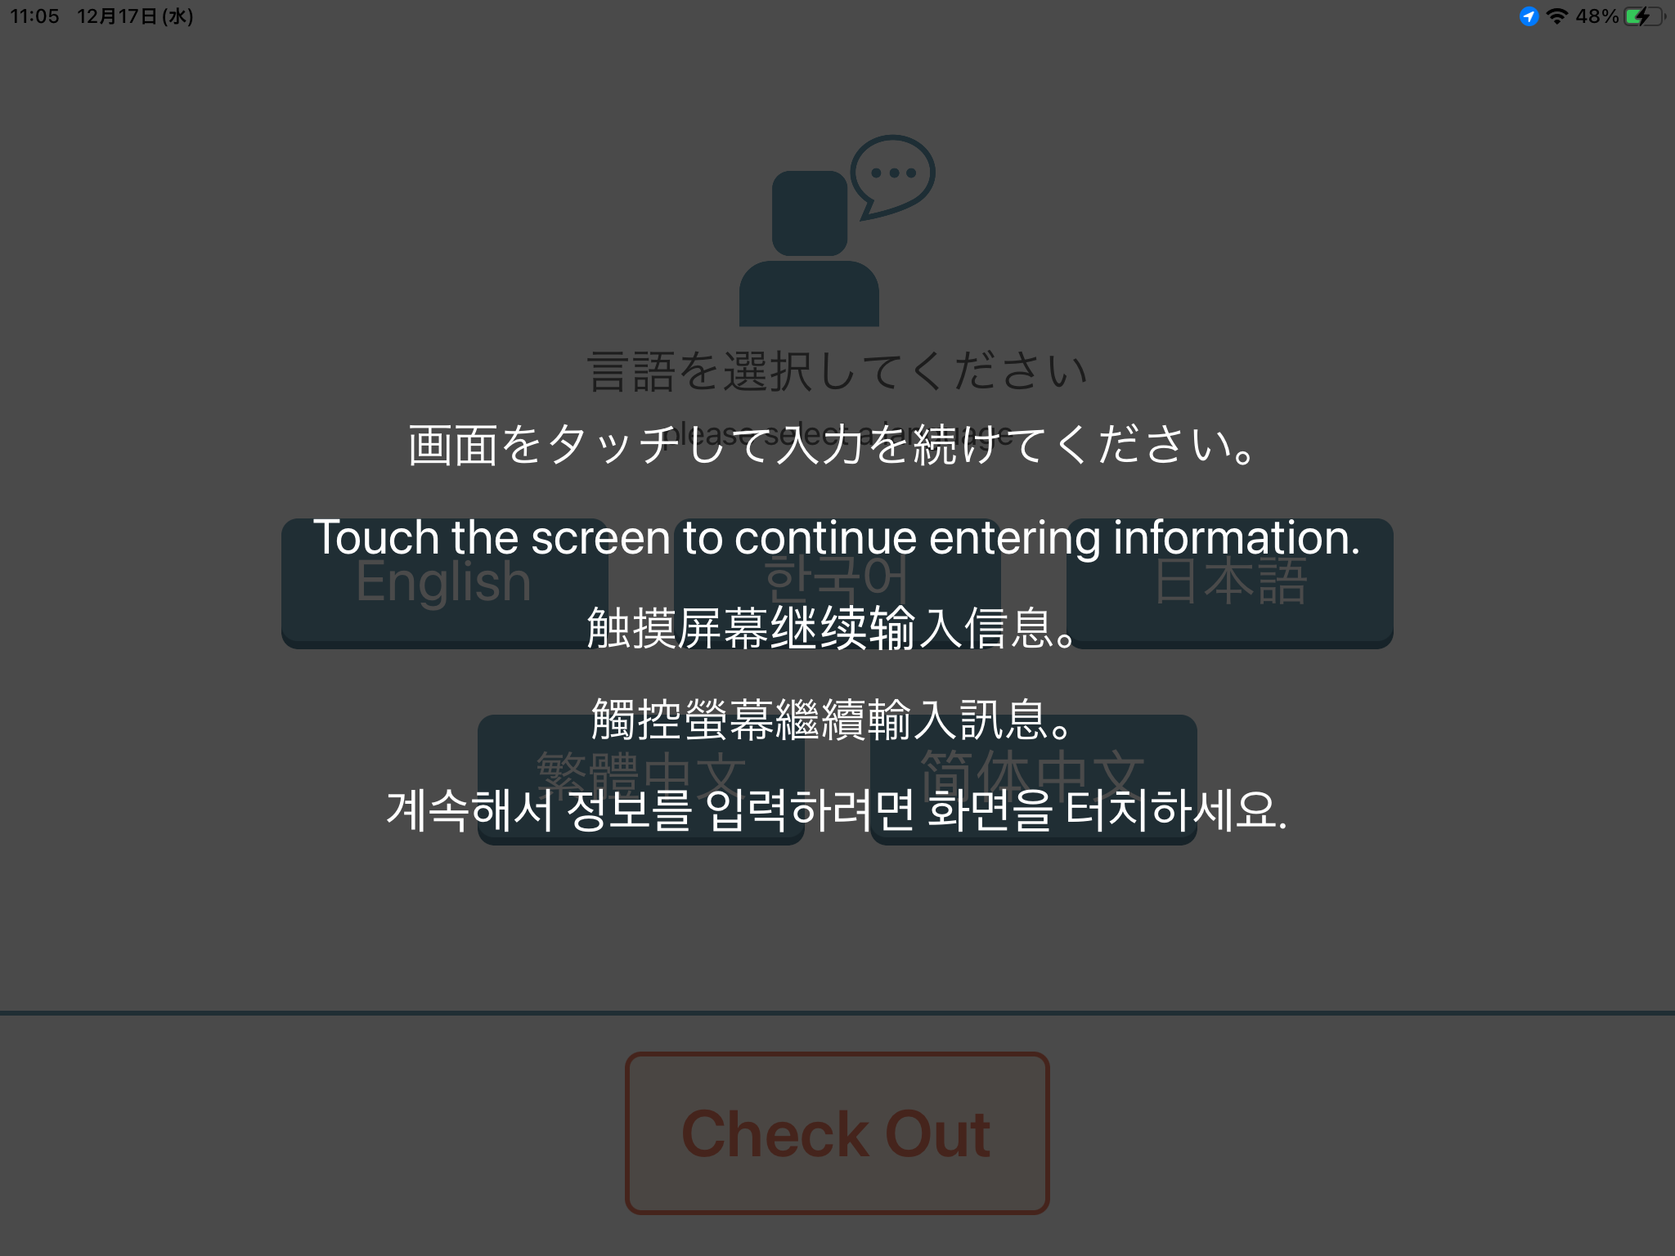
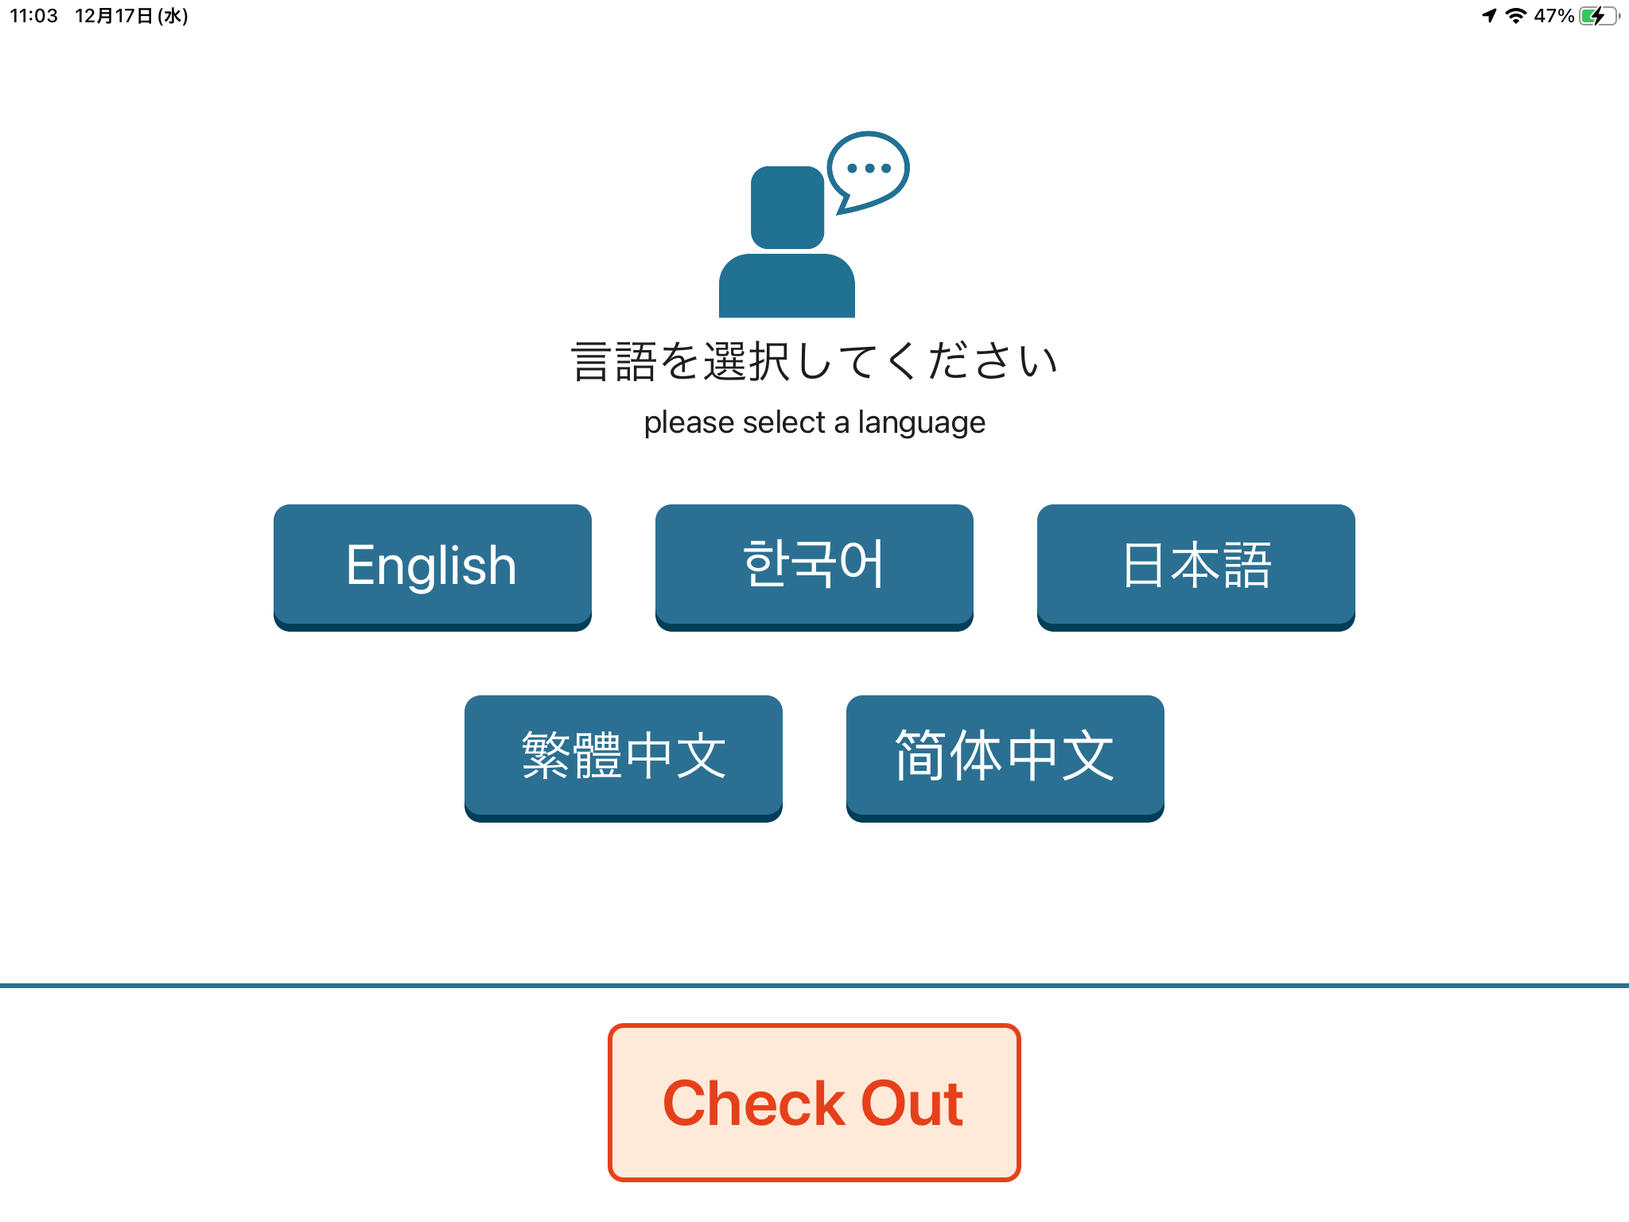
About Check-out
1. The screen may appear dim, so touch it to begin operation.
2. Tap the “Check Out” button.
ｐ.26

Slide 29
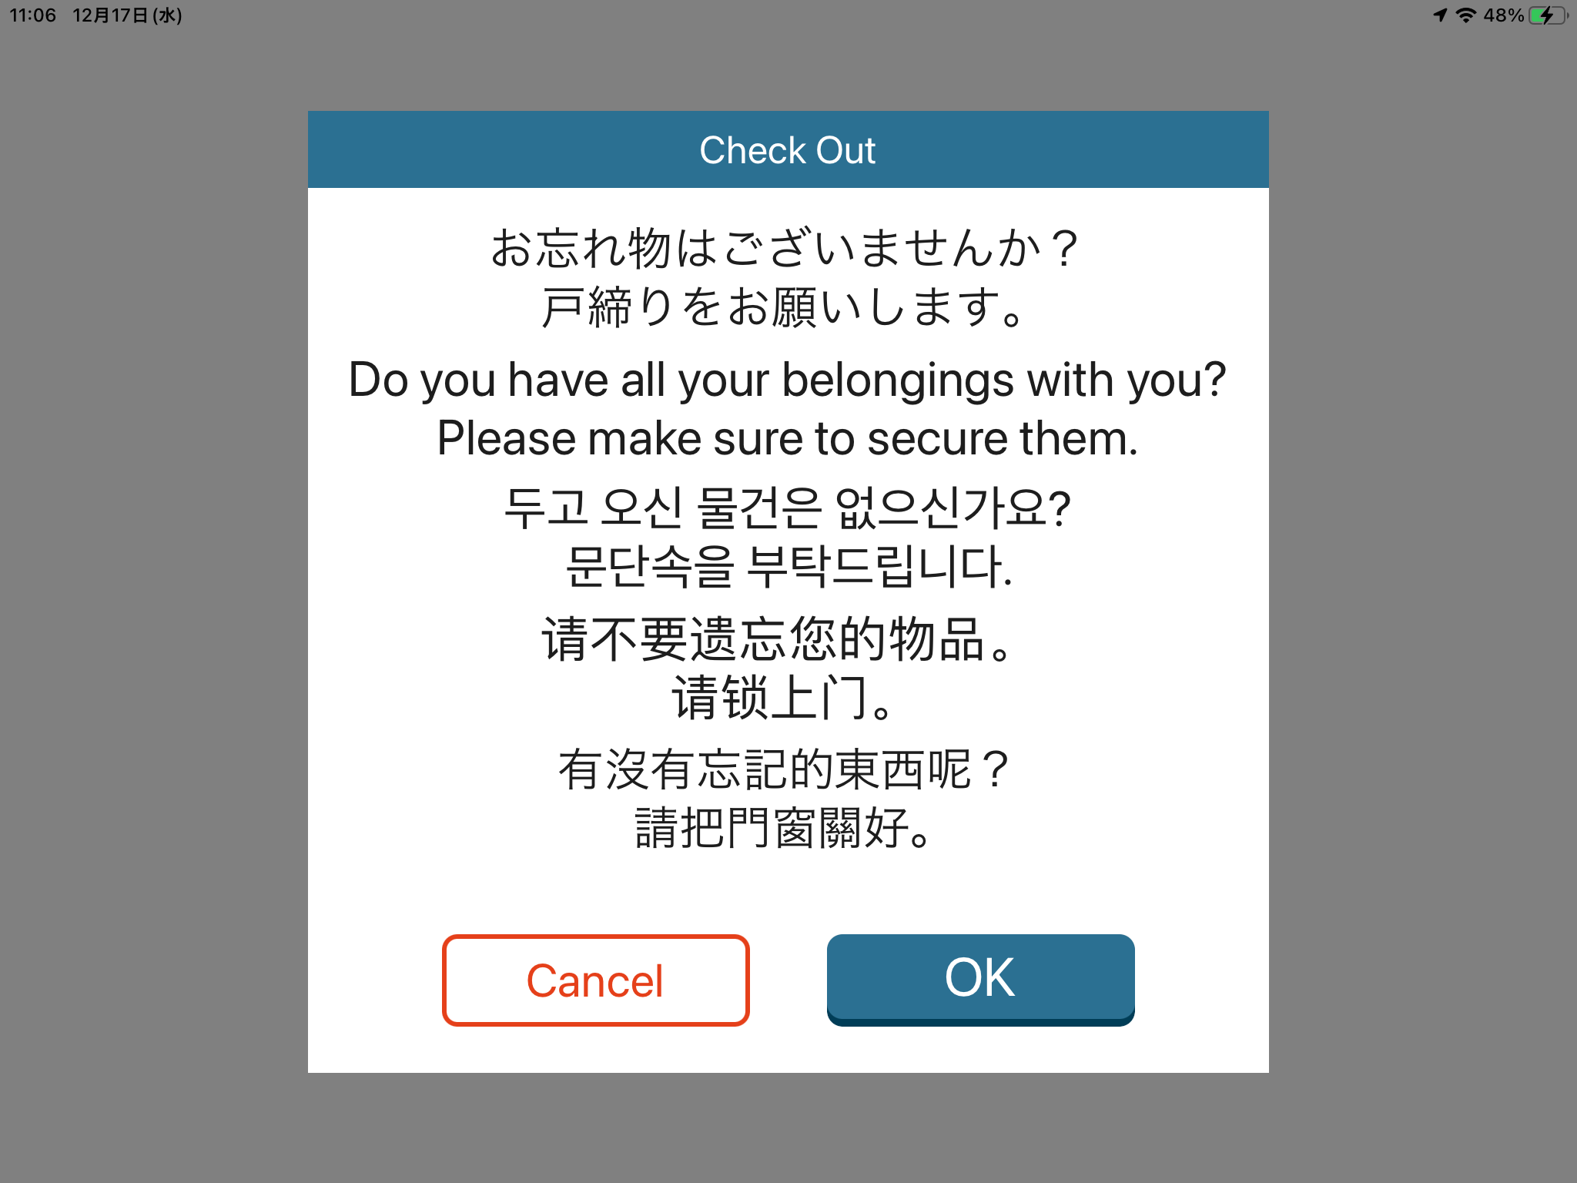
About Check-out
3. A notice regarding check-out will be displayed.
After reviewing it, select “OK.”
4. Once the screen returns to the initial page,
check-out is complete.
ｐ.27

Slide 30
About Each Function
2025.06.13 Ver.1.0
ｐ.28

Slide 31
Checking and Editing
Advance Registration Status
ｐ.29

Slide 32
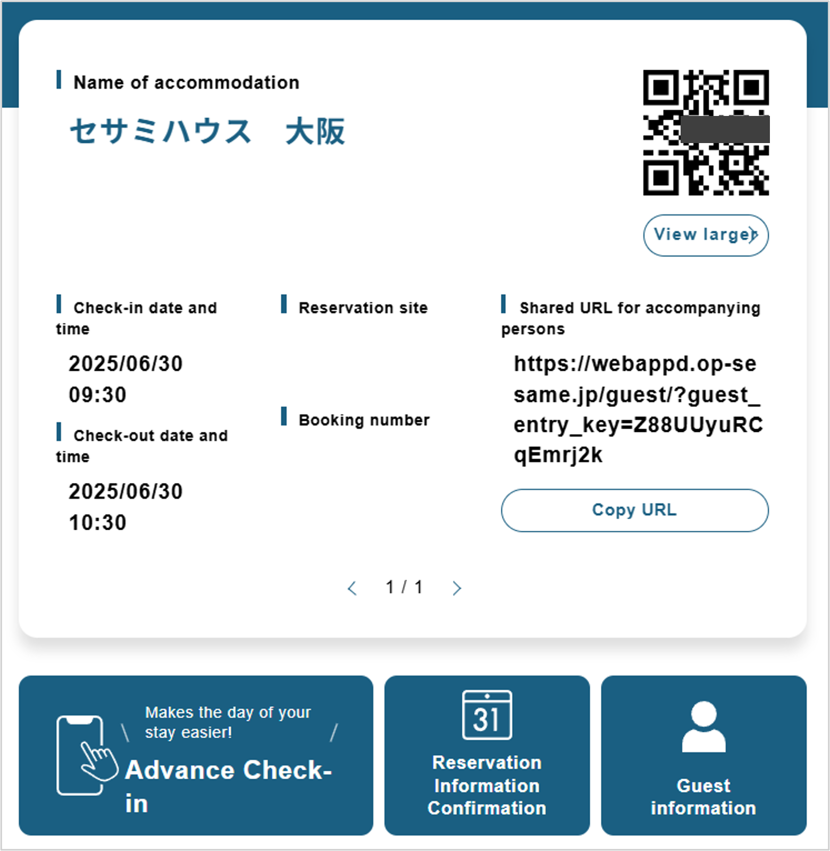
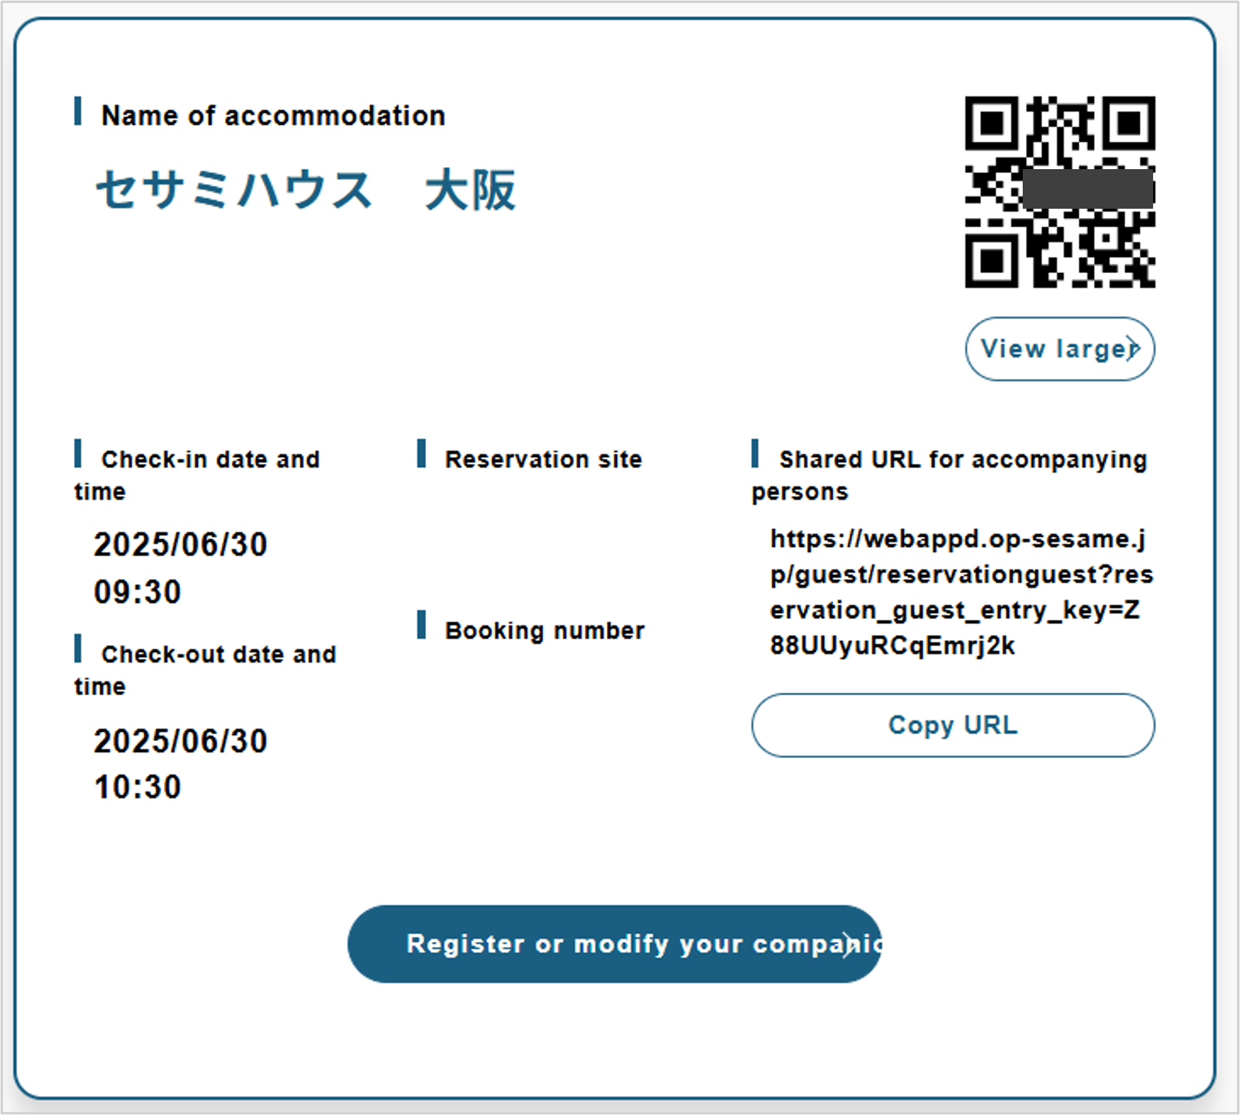
Checking and Editing Advance Registration Status
How to Check and Edit Your Registered Check-in Information
1. Log in and select “Reservation Information” from the Home screen.
2. Select “Reserve or Modify Your Companion”.
ｐ.30

Slide 33


Checking and Editing Advance Registration Status
How to Check and Edit Your Registered Check-in Information
3. Confirm the registrant whose information you wish to
edit.If any corrections are needed, select the appropriate person.
4. Make the necessary changes, then tap
“Confirm” and “Register”.
Reservations made individually through the companion URL
cannot be modified. Additionally, only the Lead Guest can
register companions from this screen.
ｐ.31

Slide 34


Checking and Editing Advance Registration Status
How to Check and Edit Your Registered Check-in Information
5. The process is complete once you reach the following screen.
↓After making changes, a confirmation email will be sent.
ｐ.32

Slide 35
Changing Your Password or Email Address,
and How to Cancel Your Account
ｐ.33

Slide 36


Changing Your Password or Email Address, and How to Cancel Your Account
How to Edit Your Account Information
1.After logging in, tap the three lines (menu icon)
at the top right from the Home screen.
2. Select "Account Information".
ｐ.34

Slide 37


Changing Your Password or Email Address, and How to Cancel Your Account
How to Edit Your Account Information
3. Select the item you wish to change, click “Edit”, and follow
the on-screen instructions to make your changes.
4.An email will be sent whenever any item is changed.
If you change your email address, a confirmation email
will be sent to the new address.
※Please note: If you have pending reservations and have not
yet checked in, the check-in QR code will no longer be valid
once you cancel your account.
ｐ.35

Slide 38
Editing Check-in Information
Registered to Your Account
ｐ.36

Slide 39

Editing Check-in Information Registered to Your Account
Edit Account Information
1.After logging in, tap the three-line menu
icon at the top right of the Home screen.
2. Select “Confirmation of Guest Information”.
ｐ.37

Slide 40





Editing Check-in Information Registered to Your Account
Edit Account Information
3. Edit the information you want to
change, then press “Confirm”.
4. On the confirmation
screen, press “Register”.
5. You will be redirected to the registration
completion screen, and a confirmation
email will be sent afterward.
ｐ.38

Slide 41
How to Issue a Reservation Only
and Complete Advance Check-in Later
ｐ.39

Slide 42



How to Issue a Reservation Only and Complete Advance Check-in Later
About Advance Check-in
1.Log in and select “Home”.Once the screen below
appears, select “Advance Check-in”.
2. Enter the authentication code shown below
the QR code in the email.
ｐ.40

Slide 43


How to Issue a Reservation Only and Complete Advance Check-in Later
About Advance Check-in
3. Register a previously issued reservation.
4. Register the guest information.
Reservations that have already been
checked out cannot be registered again.
ｐ.41

